Slide 1
Odi starter-session 14
Teacher : miss saina

Slide 2
Page 22/questions:
1.Where is here?
2.What can you see in the zoo?
3.How many boys and how many girls can you see?
4.Where are the monkeys?
5.What is elephant eating?
6.Where is the hippo? Its in the water.

Slide 3
Page 22/questions:
7.Why is the boy crying in front of elephant? Because the elephant ate his ice cream
8.How many trees can you see?
9.What can you see on the ground? I can see some stones.
10.Which animals are wild? All of them are wild.
11.Why is the girl crying? Because she does’nt want to leave the zoo.
12.Who takes care of the animals? The zoo keeper.

Slide 4
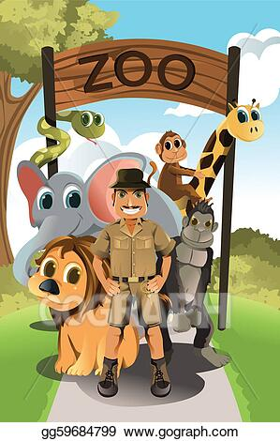
Zoo keeper: A person who takes care of the animals. Also the zoo keeper feed and clean them.

Slide 5
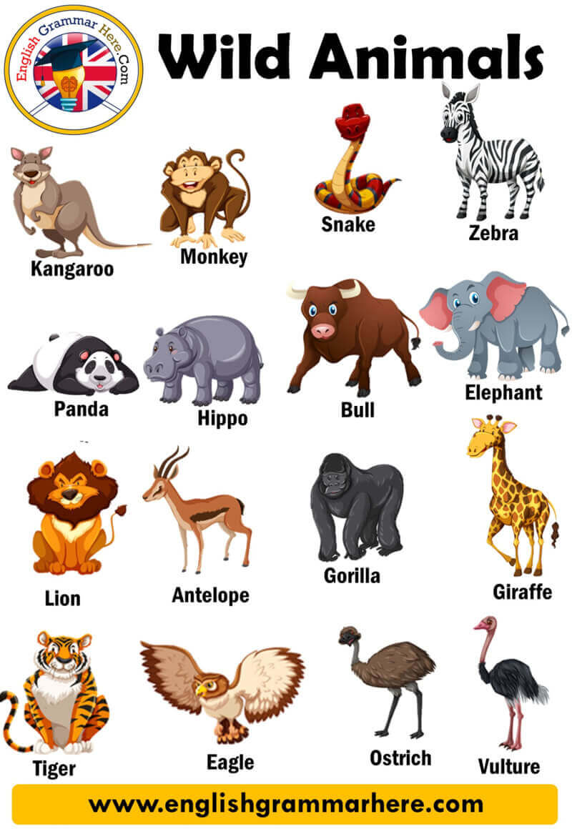
Wild animals(review):
Wild animals like:
Lion
Tiger
Giraffe
Zebra
Elephant
Gorilla
Snake
Monkey
Hippo,
…

Slide 6
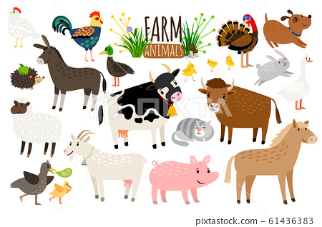
Farm animals(review):
Farm animals like:
Sheep
Cat
Dog
Horse
Rooster
Chick
Pig
Donkey
Cow
Rabbit,
…

Slide 7
Personal questions:
1.Do you like zoo?
2.Did you ever go to the zoo? Yes I did.
3.What is your favourite animal in the zoo?
4.Can you feed the animals in the zoo? No we can’t feed the animals.

Slide 8
Personal questions:
5.Can you touch the animals in the zoo? No I cant touch them.
6.Are you an animal lover? Yes I am/ No I’am not.
7.Do you have pet in your house?

Slide 9
Homework:
1.Write the questions in your notebook.
2.Memorise and review farm and wild animals.
3.Do 2 pages of activity book.

