Slide 1
Odi2part3-session2
Teacher: miss saina

Slide 2
Page 50 story:
Professor Bloom and kids are in the forest.
Princess Emily is smelling the pretty yellow flower.
Lindy is looking at the small insects with magnifier.
Joe is climbing up the hills to see the animal which is sitting on top of the hill.
A frog is in the pond and it’s so angry because professor is throwing some stones in the pond!
Pippin is happier that everyone because he found new friends in the forest.
They were so glad and also they took all their trashes while they leaving.

Slide 3

Magnifier:

Slide 4
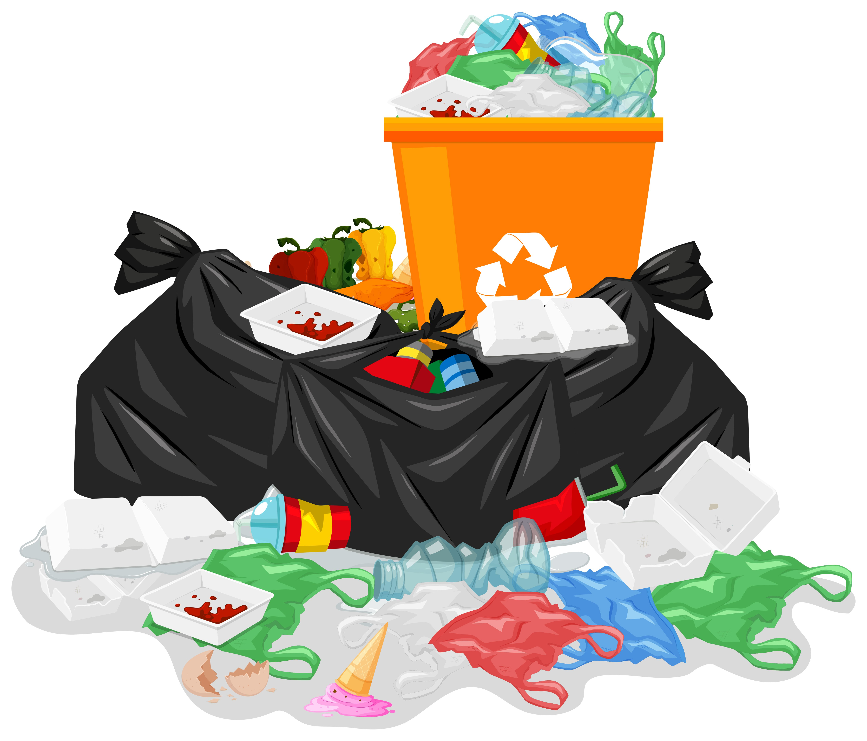
Trash:

Slide 5
What should we do after picnic in jungle?
1.We should pack our stuffs and don’t leave them in the nature.
2.We should put all of our trashes in a plastic and don’t leave them on the ground because it’s harmful for animals, plants and our environment.
3.If we had extra food we can give it to hungry animals that they may be there.
4.We should wash our hands very well and clean our clothes too.
5.If we made fire we must turn it off before going because its very dangerous for trees.

Slide 6
homework
1.memorize the story of unit 5.
2.memorize the text in slide 5.
3.do 2 pages of activity book.

