Slide 1
Odi2part3-session4
Teacher: miss saina

Slide 2
Unit 5 questions:
1.Where are they?
2.Who are they?
3.What is professor bloom doing?
4.What is Lindy doing?
5.What is princess Emily doing?
6.What is Joe doing?

Slide 3
Unit 5 questions:
7.Where is the frog?
8.Why is the frog angry?
9.What is in Lindy’s hand?
10.What is Lindy looking at?
11.How many birds can you see?
12.Who found some new friends in nature?

Slide 4
Page 52:
Catch butterfly: you mustn’t catch the butterfly because it will die soon.
Pick the flower: you mustn’t pick the flower because it will be withered.
Water the plants: you must water the plants because they need water to stay alive and grow.
Feed the birds: its better that you put some bread, rice or seeds for hungry birds.
Be kind to animals: we must be kind to animals because they are living like people and we shouldn’t hurt them.

Slide 5
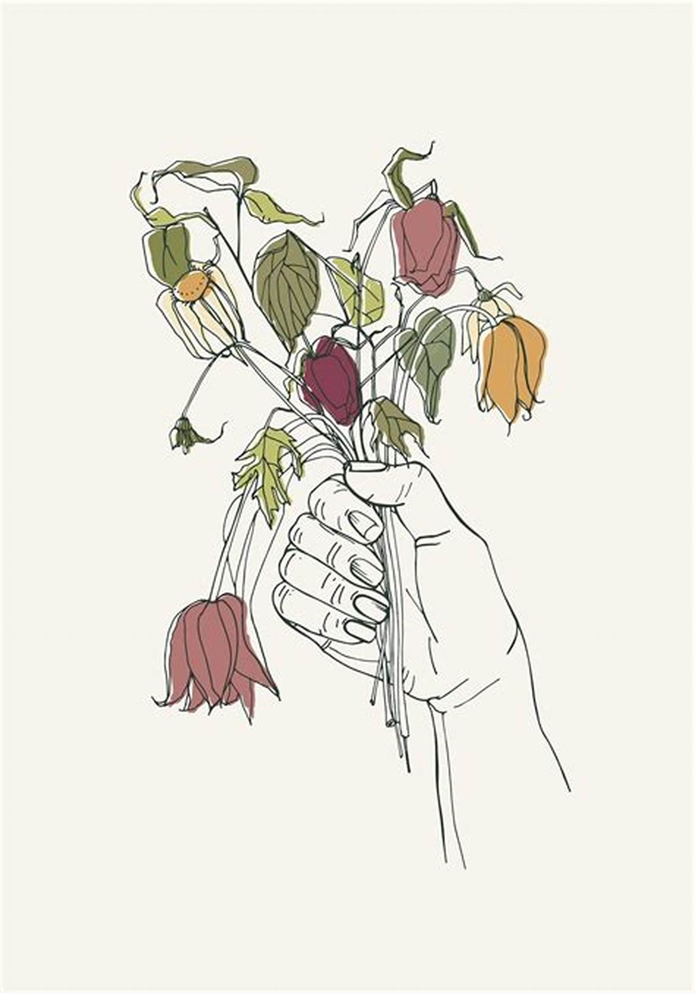
Withered flower

Slide 6
Page 52:
Throw stones: we mustn’t throw stones to birds or other animals because it might hurt them or they might die.
Walk on the grass: we mustn’t walk on the grass because they will break.
Drop the litter: we mustn’t drop the litter on the ground, it’s harmful for all animals and plants and also people too, because they have a lot of pollution.

Slide 7
Homework:
1.memorize the sentences of power point.
2.Do 2 pages of activity book and 1 page of grammar book.

