Slide 3
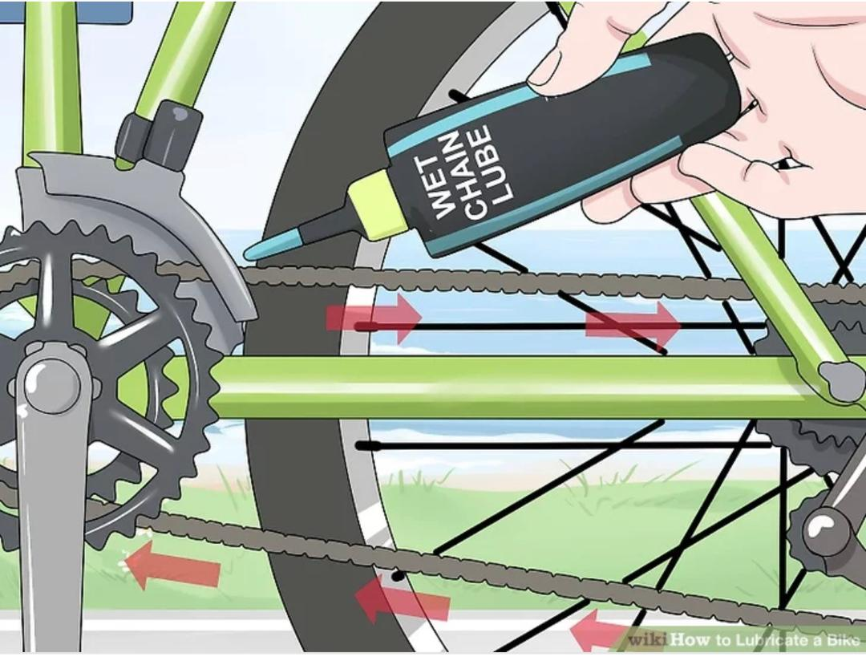
chain
My brother put oil on the bicycle chain.

Slide 5
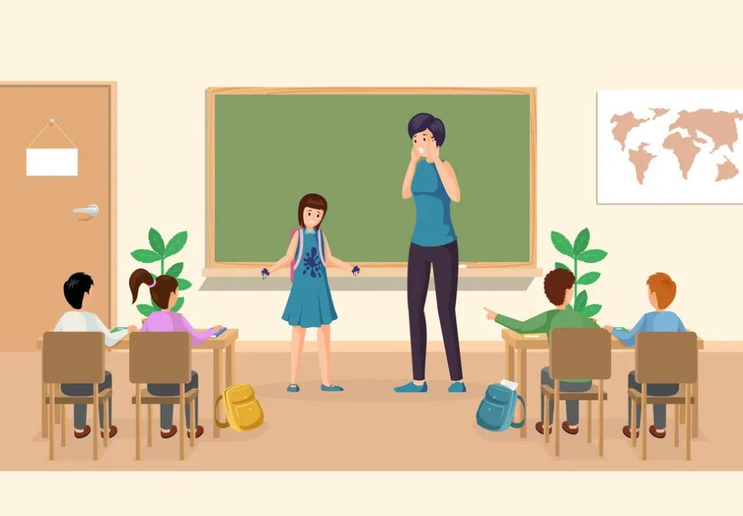
late
sorry I’m late,I overslept.

Slide 6
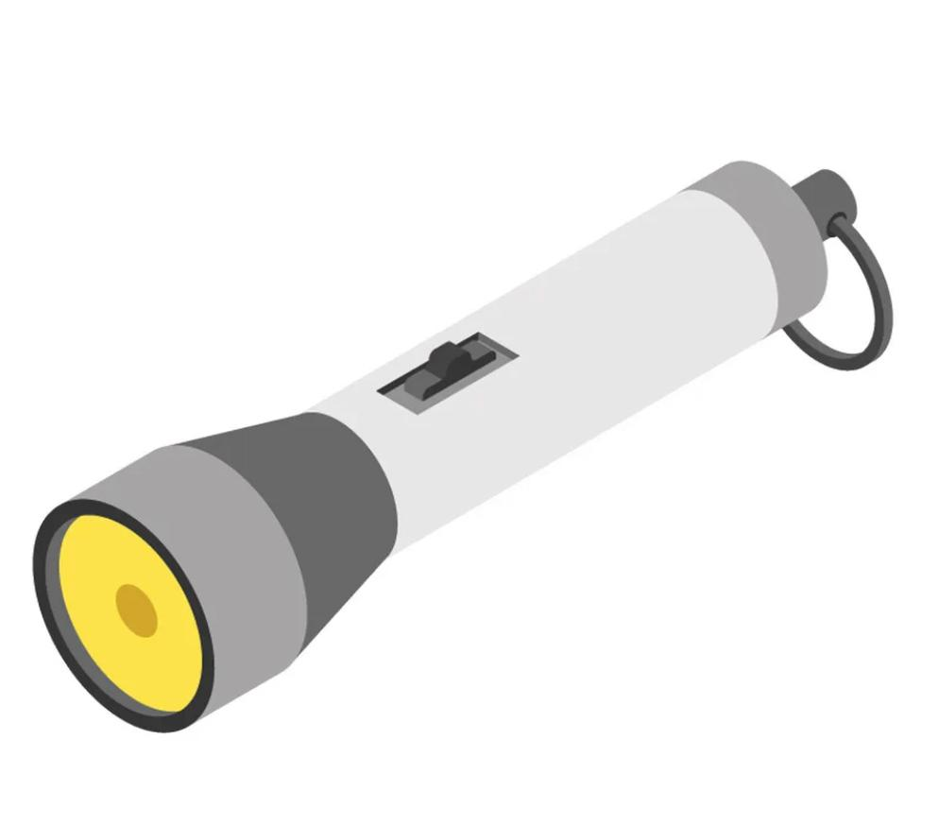
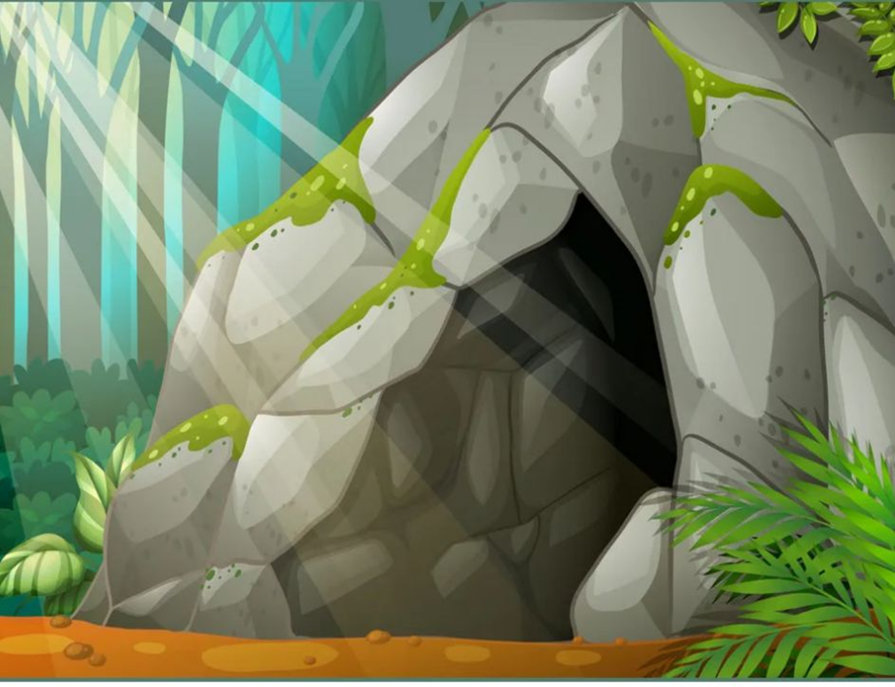
cave
The cave is too dark, I need a torch .

Slide 7
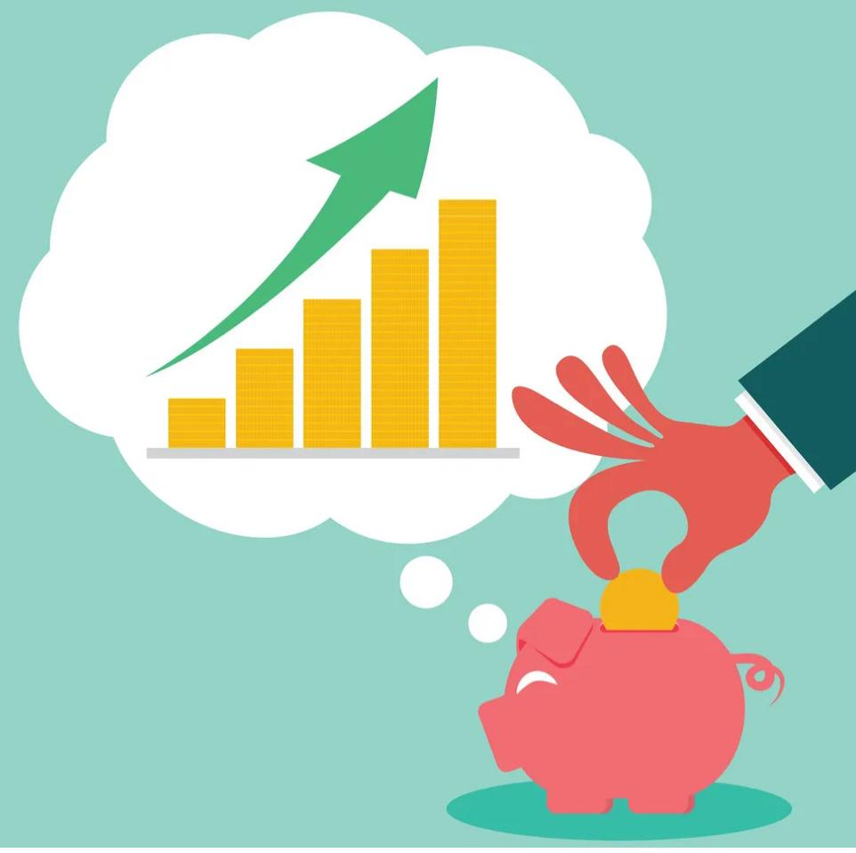
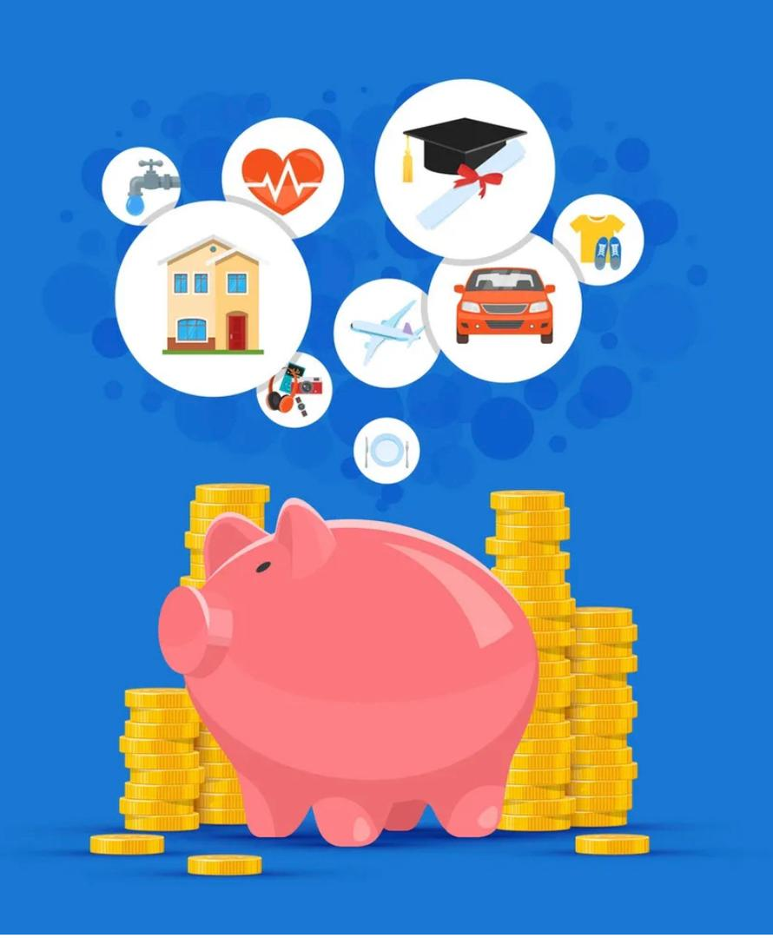
save
My father is saving money to buy a new car.

Slide 9
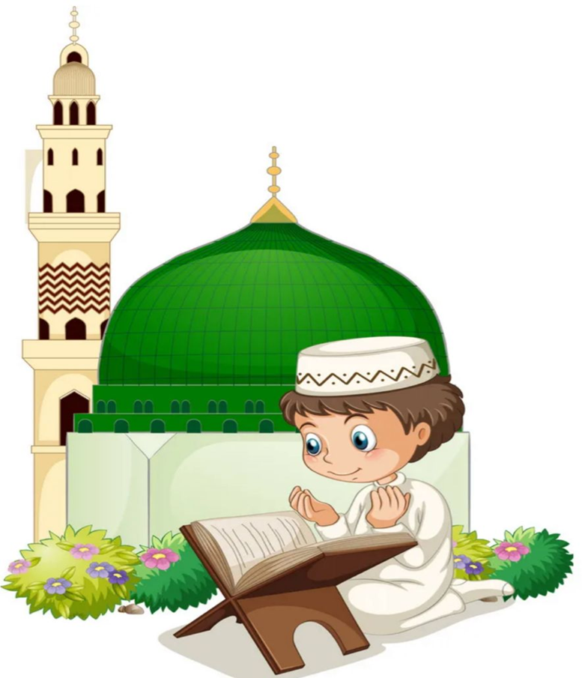
people go to the mosque to pray.
pray

Slide 10
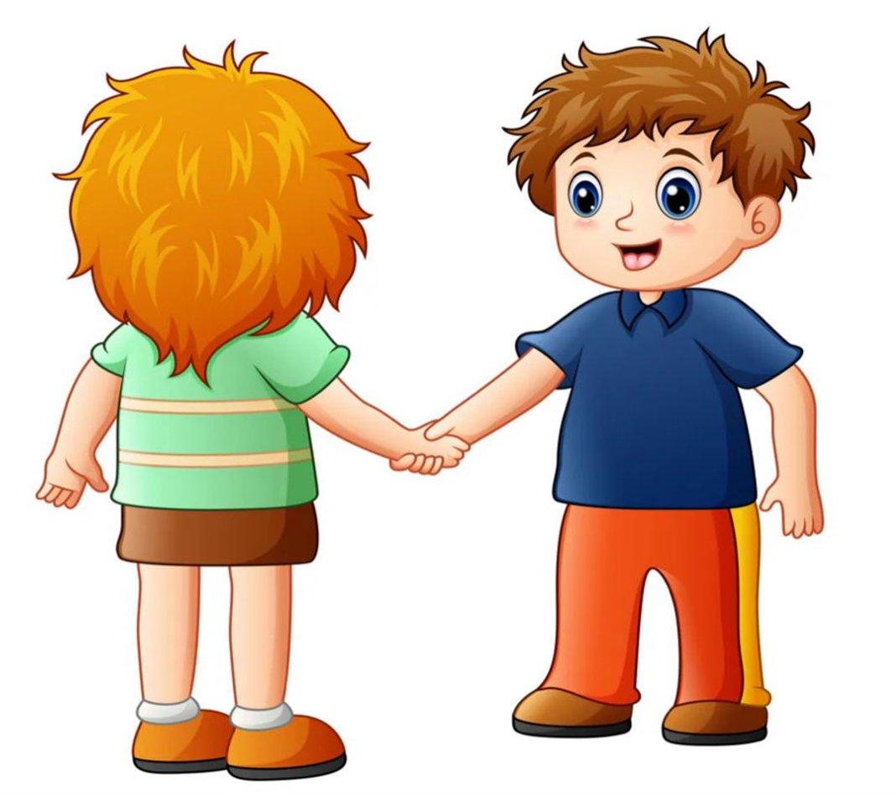
stay
Stay here, I’ll be back in a minute.

Slide 15
