Slide 2
The goats can climb the hills and the rocks.

Slide 3
We have toast and jam for breakfast.

Slide 4
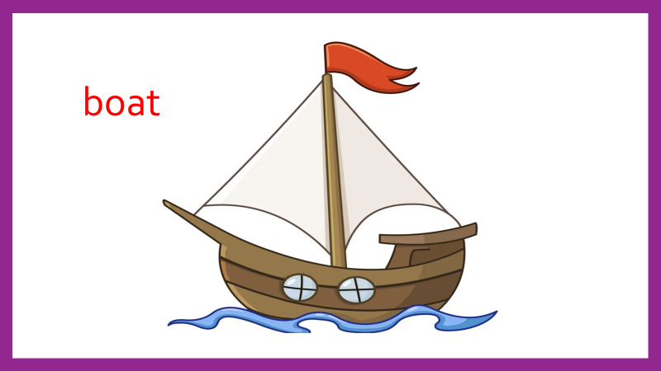
Can you row a boat?

Slide 6
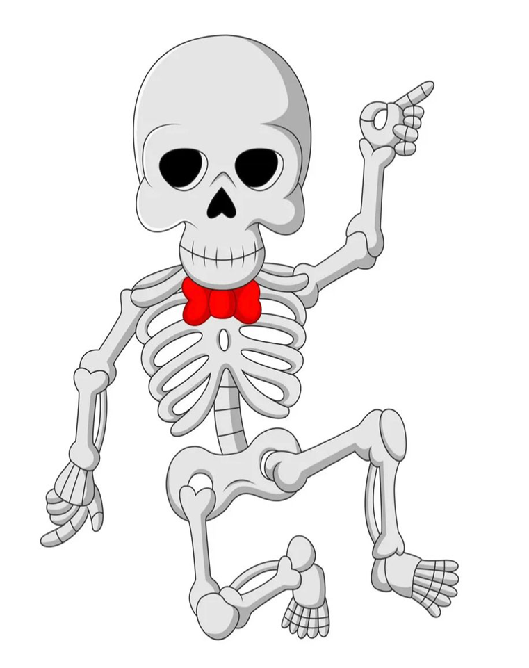
The x-ray shows that the bone is broken.

Slide 7
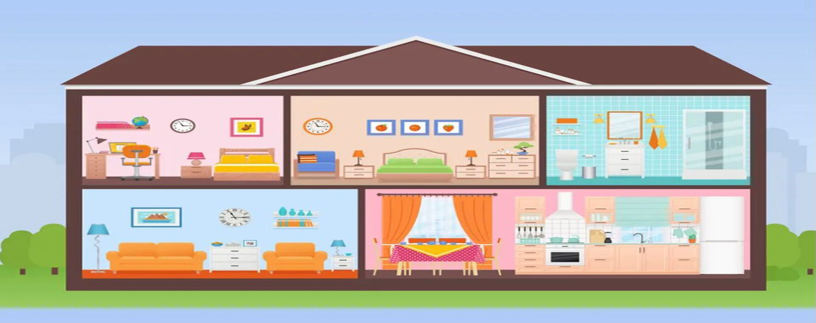
Last night we stayed at home and watch tv.

Slide 9
I can see foot prints on the snow.

Slide 10
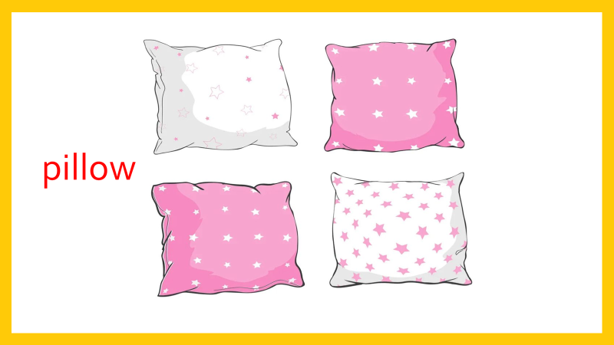
The pillow is full of feathers.

Slide 14
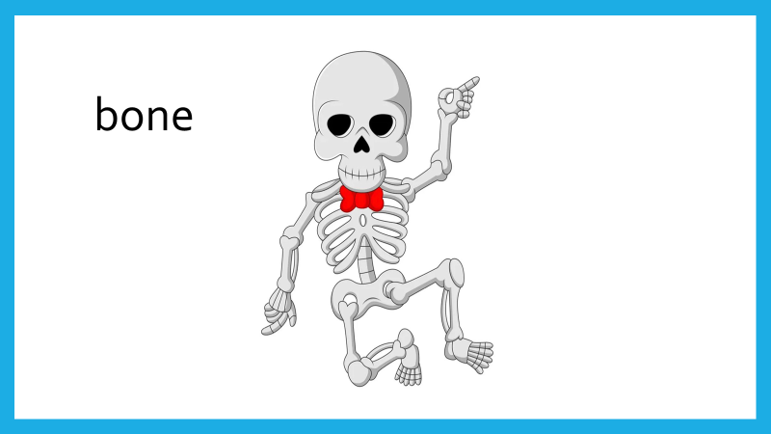

Slide 15
