Slide 1
Odi starter-session 15
Teacher : Miss Saina

Slide 2
Page 24/Story
Wawa is thinking about his family.
His father is a doctor and he works in the hospital.
His mother is a piolet and she works at the airport.
He has got 1 brother, he is 7 years old.
He has got 1 sister, she is 9 years old.
He has got a friend.
It's name is Waldo,
Waldo is a dragon , it's green and it has got 2 wings.

Slide 3
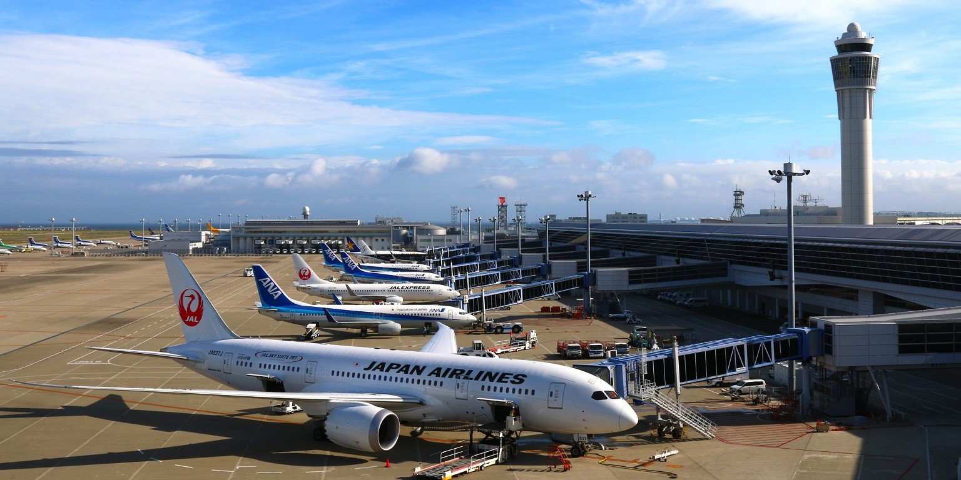
airport

Slide 4
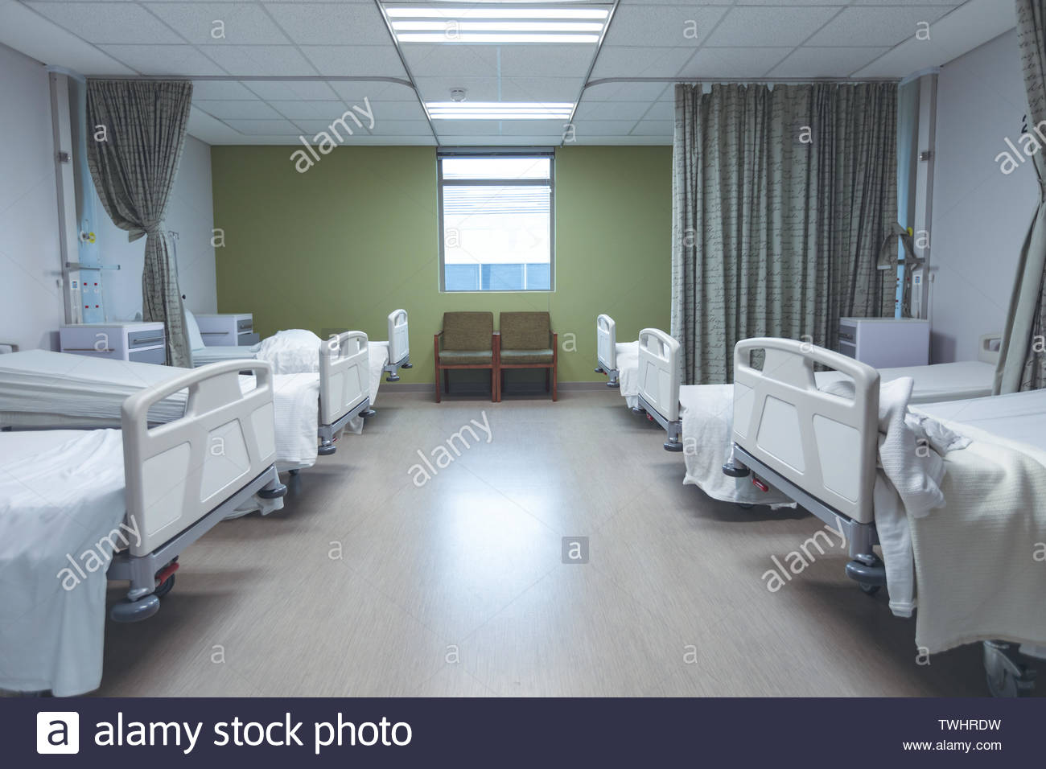
hospital

Slide 5
Page 24/Questions
1.Who is the baby?
2.What's his father's job?
3.What's his mother's job?
4.How many siblings does he have?
5.How old is his brother?

Slide 6
Page 24/Questions:
6.How old is his sister?
7.Where does his mother work?
8.Where does his father work?
9.Who is his friend?
10.What color is it?

Slide 7
homework
1.Memorise the story of page 24.
2.Write the questions in your notebook.
3.Memorise the questions.

