Slide 2
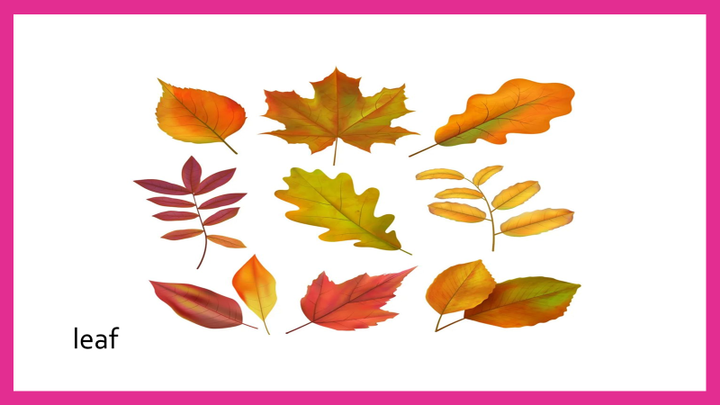
The leaves fall down the trees in fall.

Slide 3
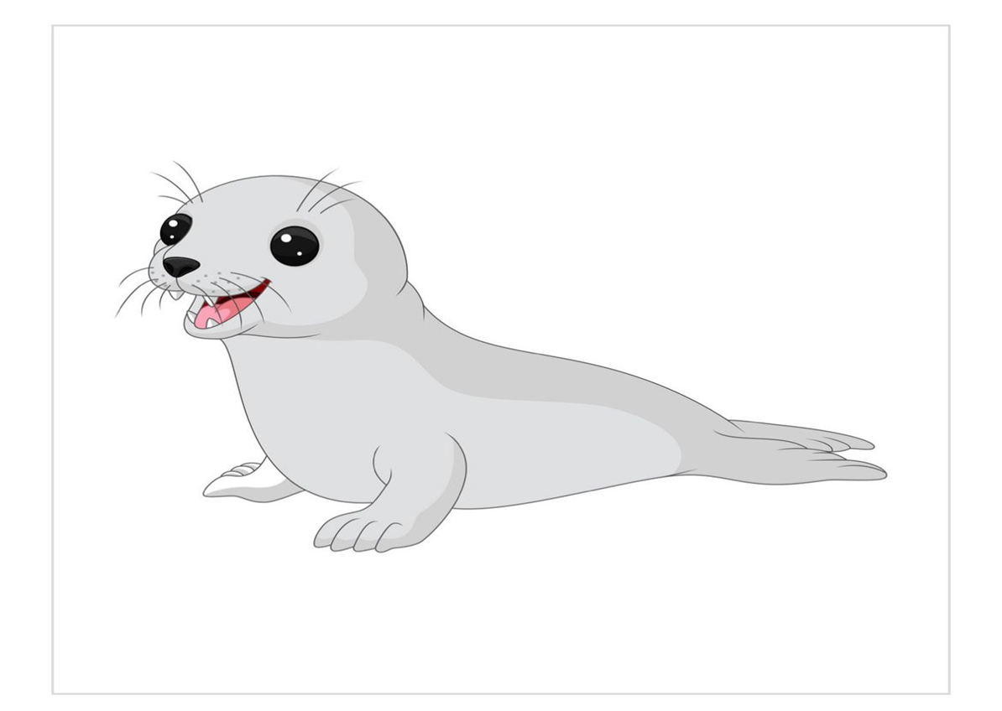
The seal lives around the sea.

Slide 5
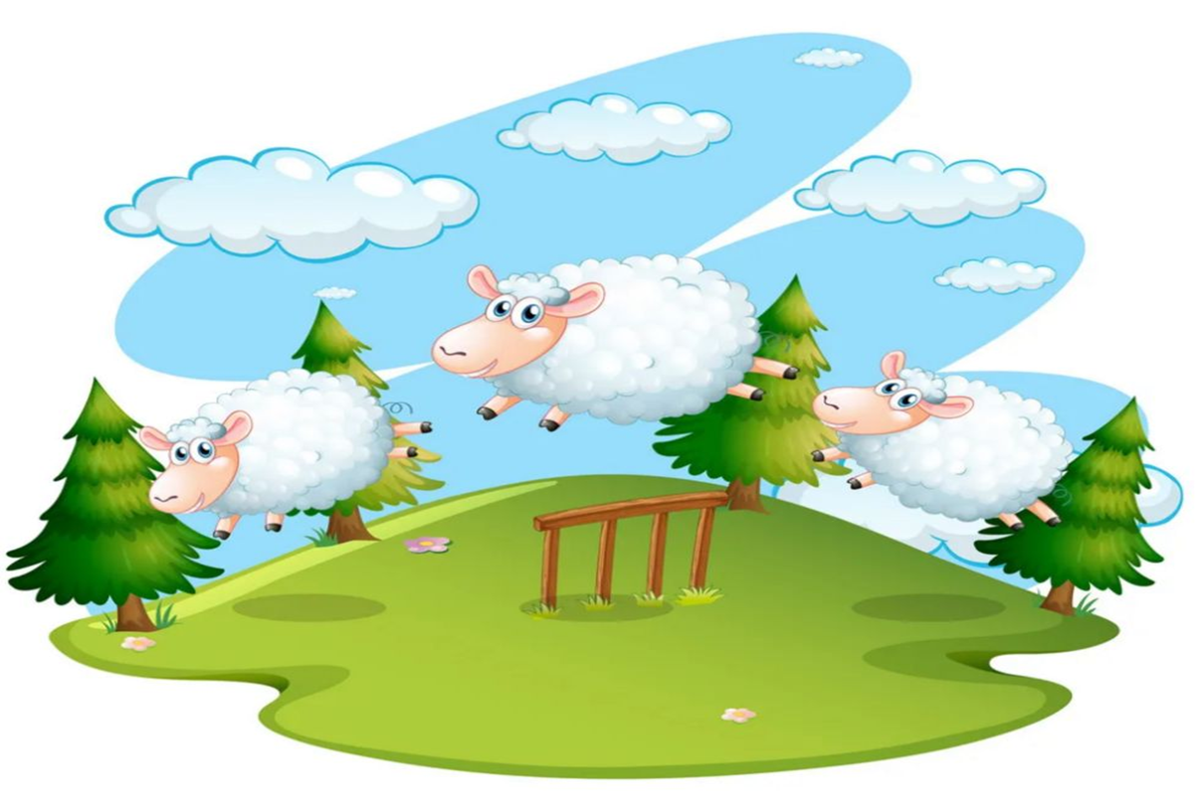
The sheep are grazing on the hill.

Slide 6
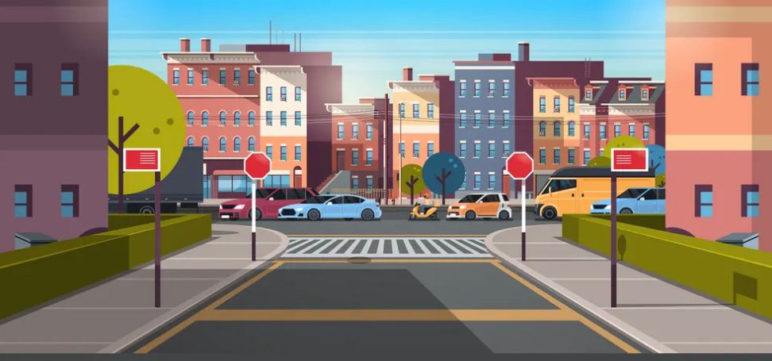
street
The street was full of cars , I can’t park .

Slide 8
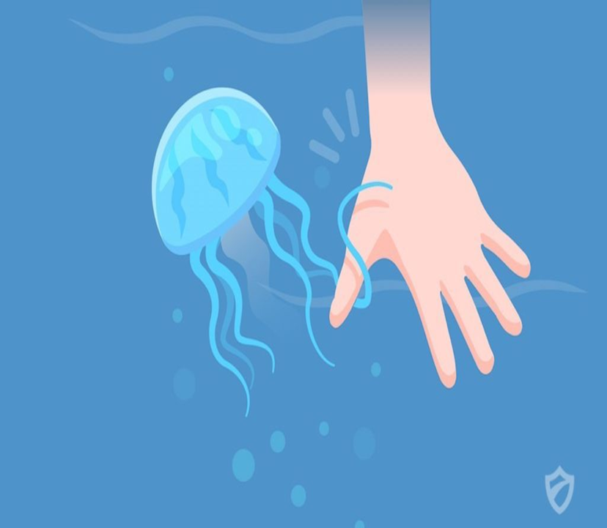
The jelly fish can sting you.

Slide 9
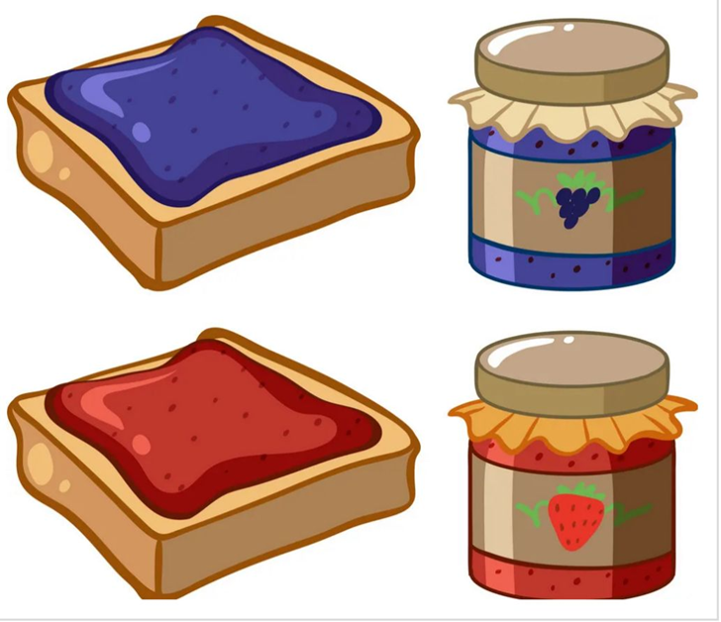
My mother spreads jam and butter on the bread.

