Slide 1
w

Slide 2
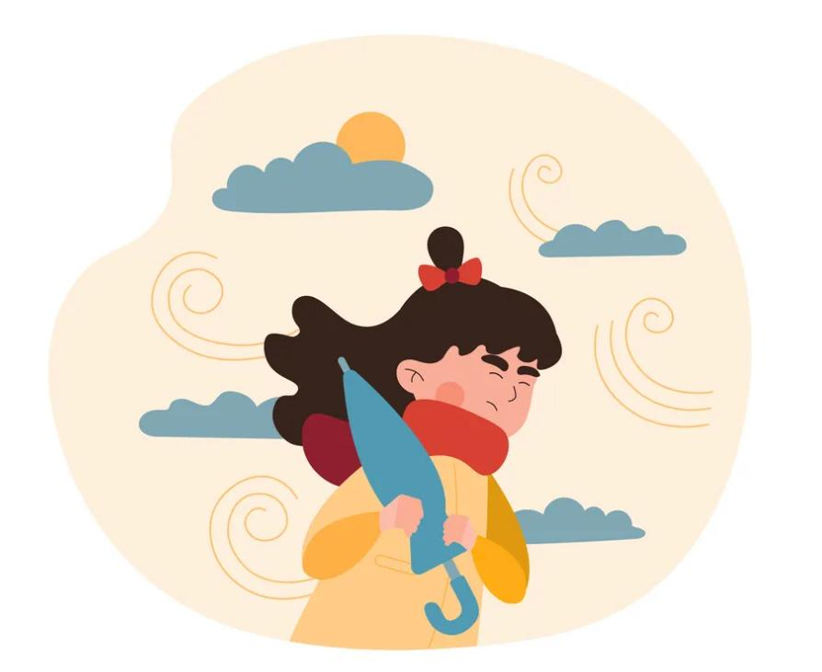
wind
I can’t stand here the wind is so strong.

Slide 3
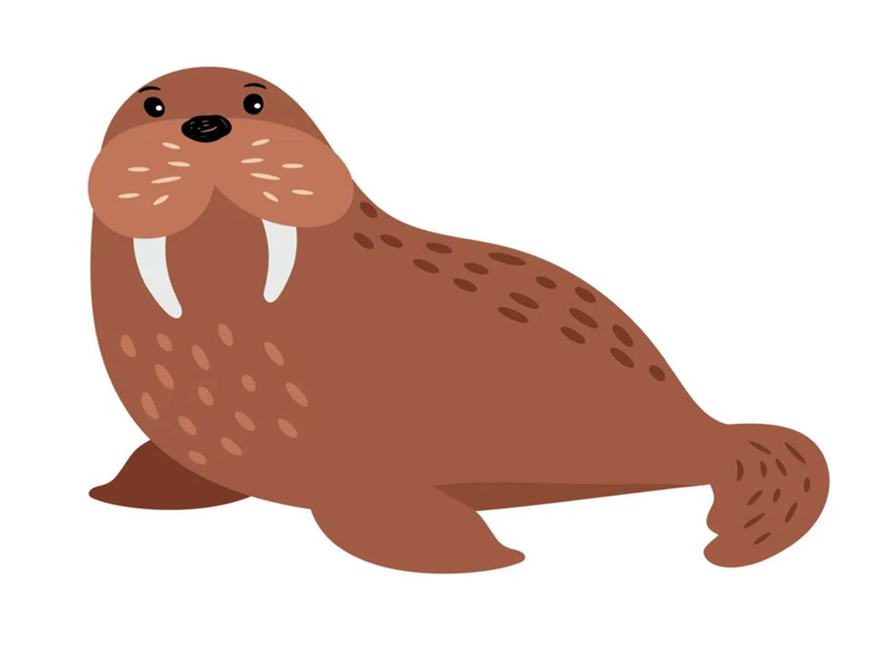
The walrus has 2 long teeth.

Slide 4
ng

Slide 5
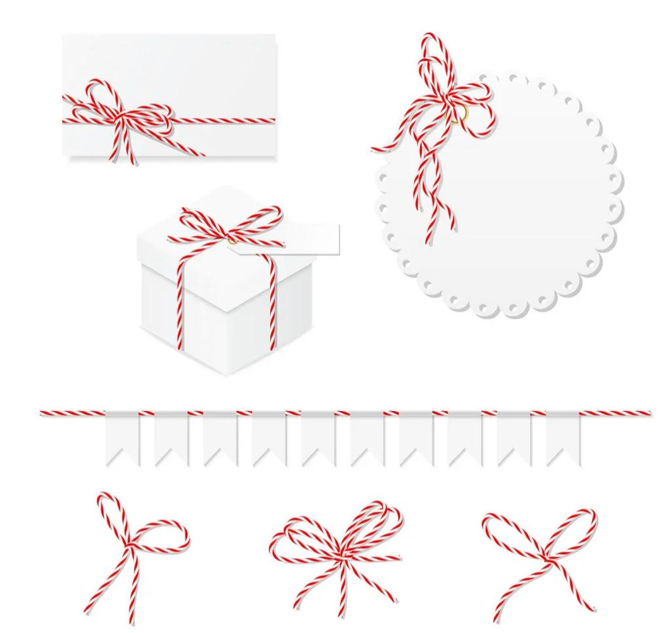
string
I need string to tie this box .

Slide 6
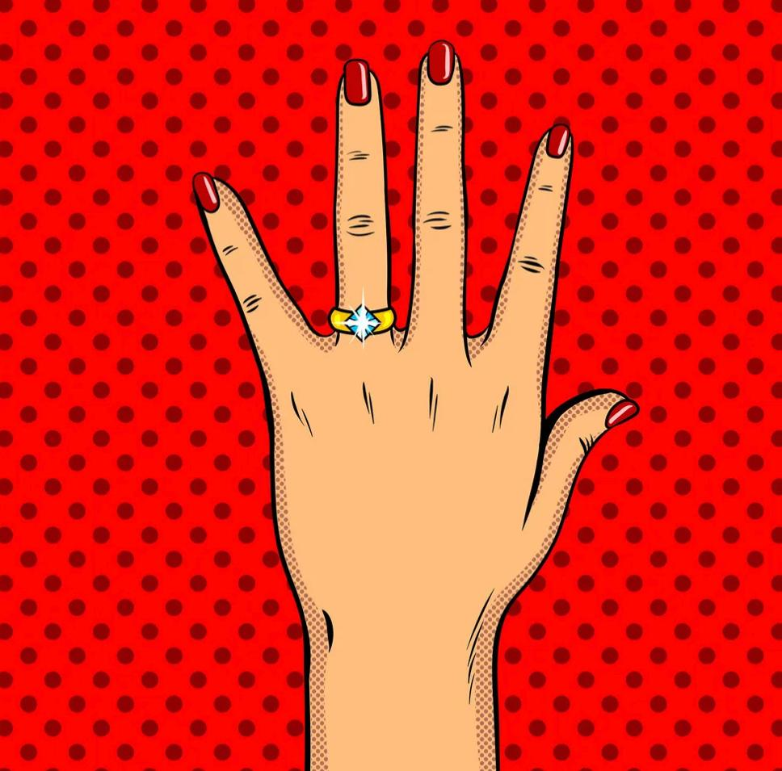
ring
My mom wears a golden ring on her left hand.

Slide 7
z

Slide 8
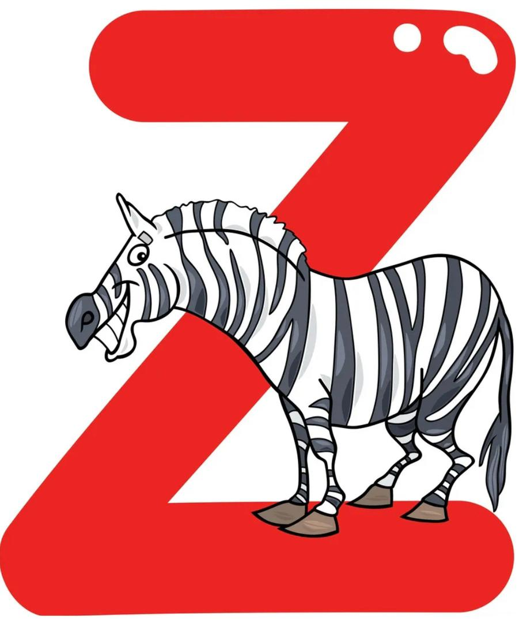
The zebra is striped.
The zebra looks like a horse.

Slide 9
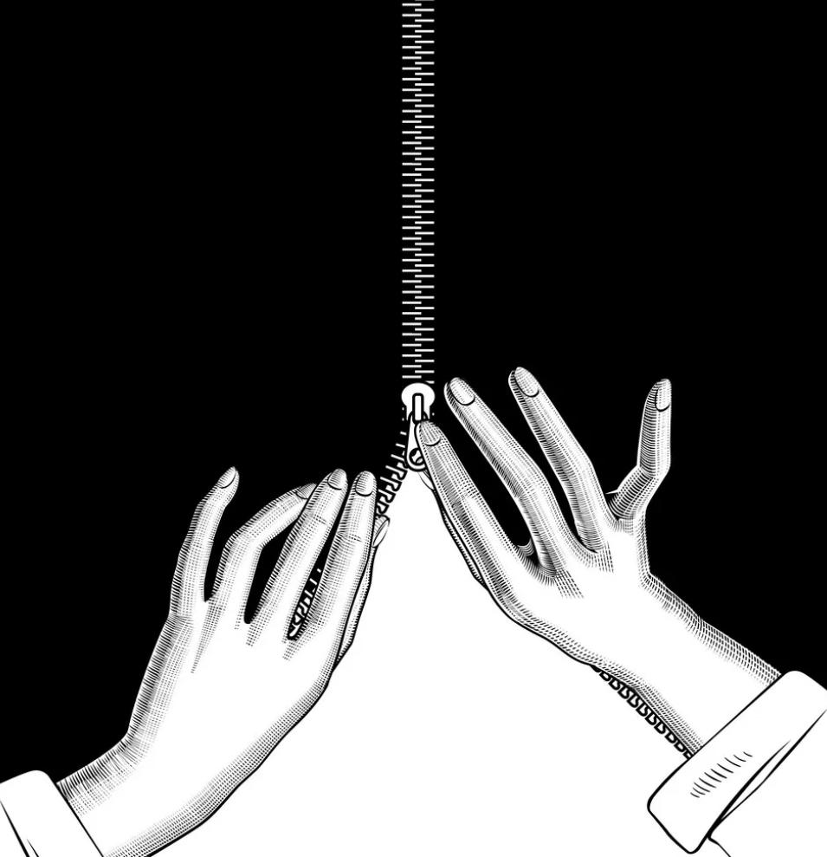
Do up my zip at the back.

Slide 10
v

Slide 11
van
The van is full of passengers.

Slide 12
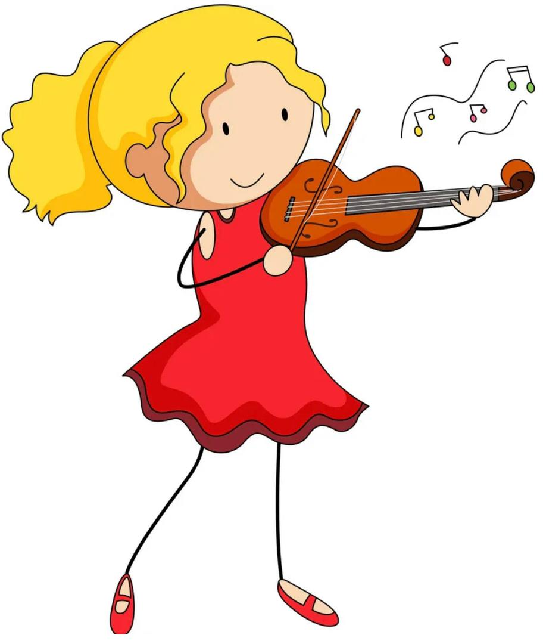
playing the violin is really hard.

Slide 13
oo

Slide 14
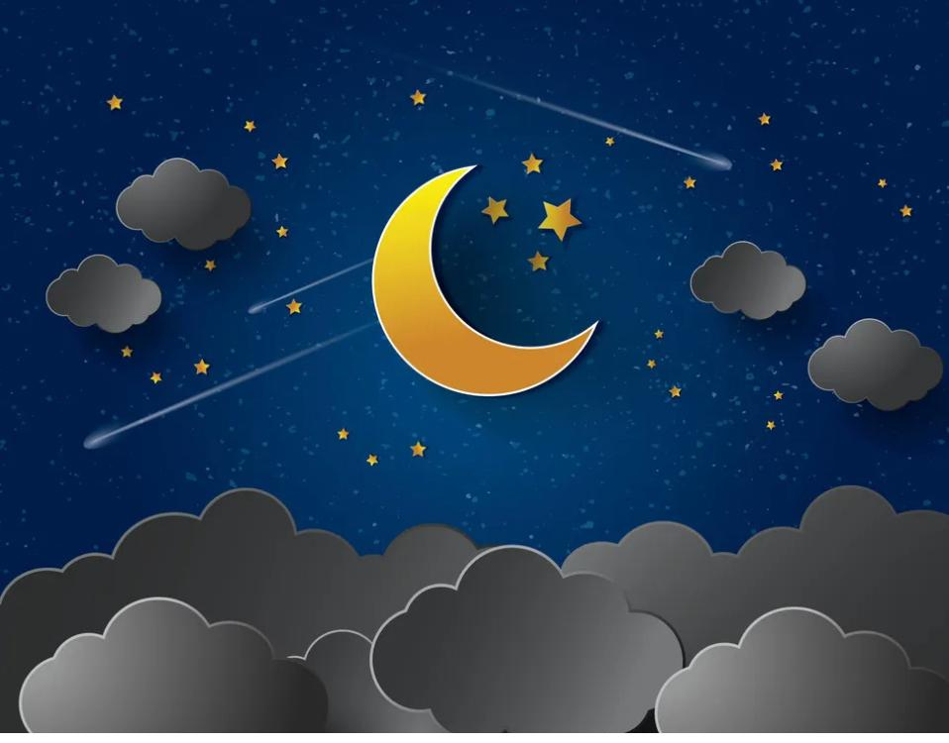
The moon comes out from behind the clouds.
moon

Slide 15
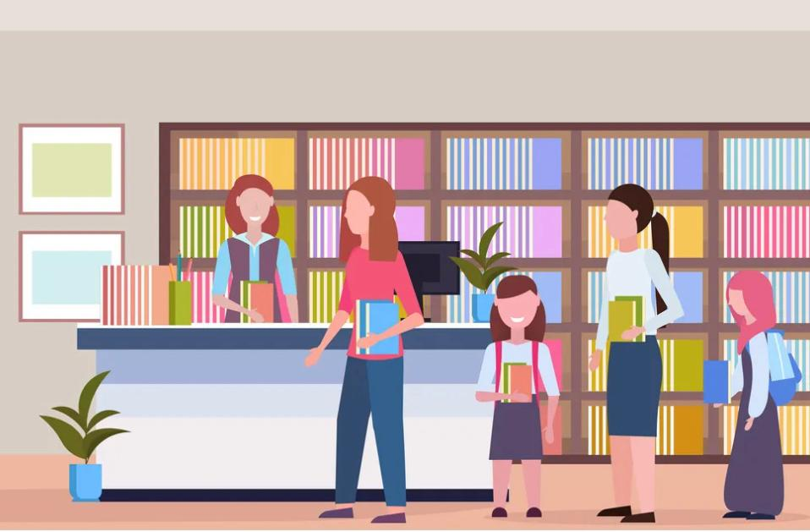
book
I borrow a book from the library.

Slide 21
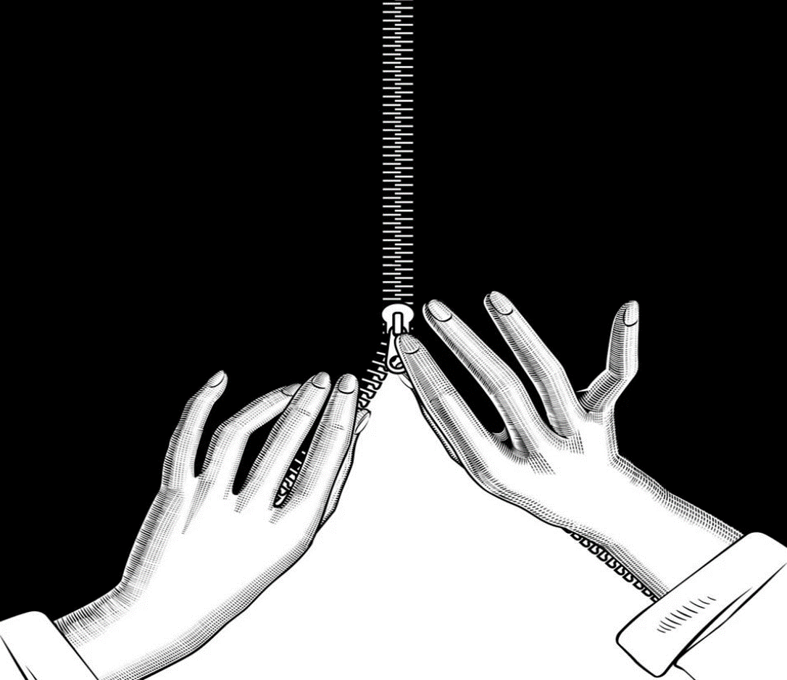

Slide 22
