Slide 1
er

Slide 2
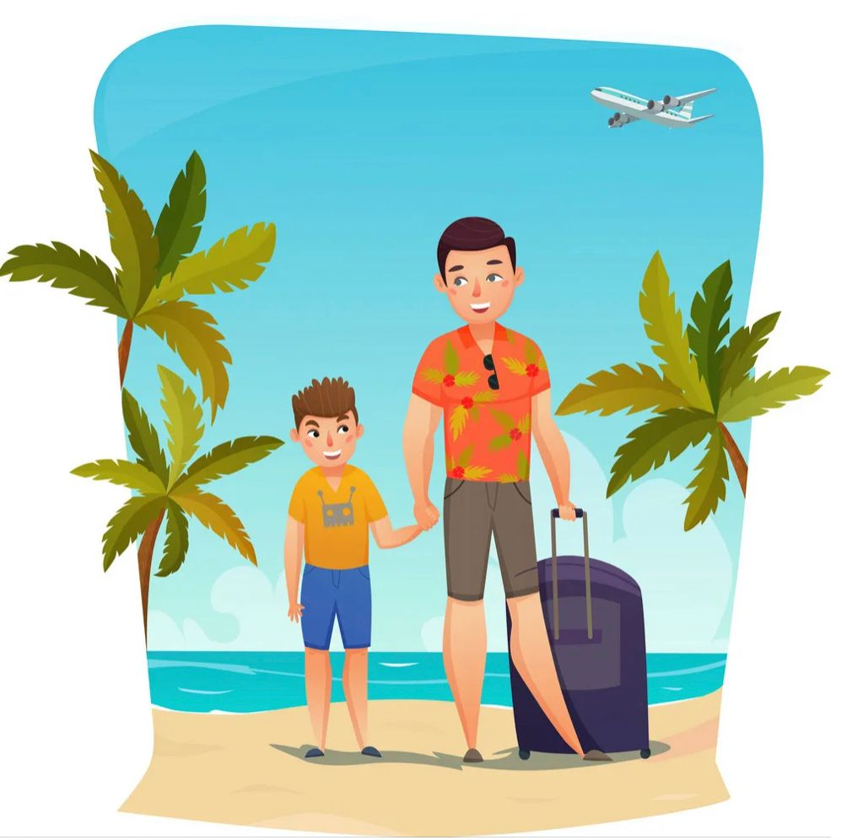
summer
Where are you going for your summer holiday?

Slide 3
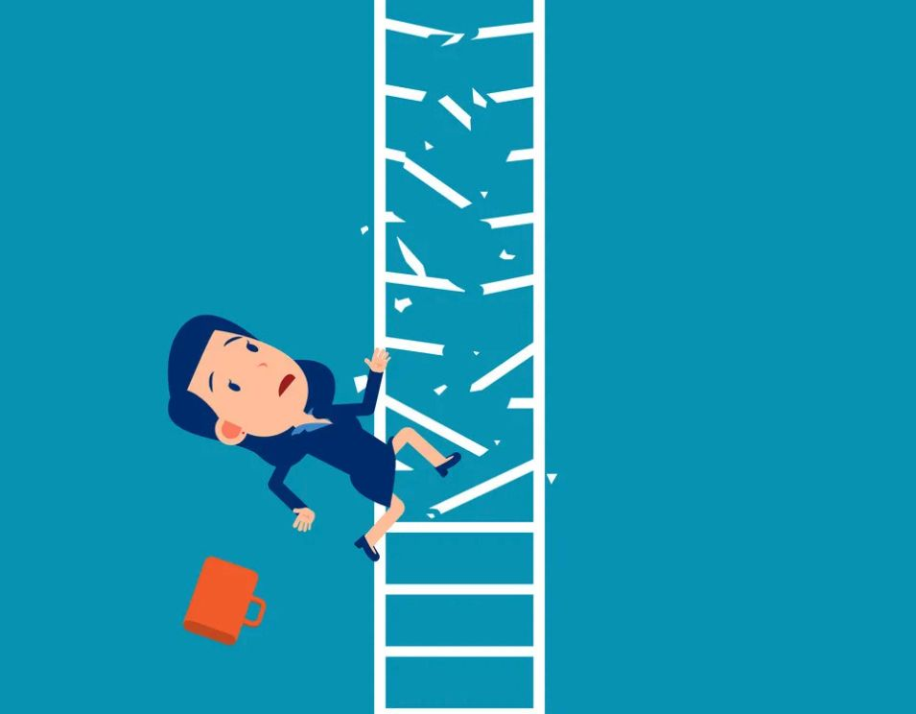
ladder
she fell off the ladder and hurt herself.

Slide 4
ir

Slide 5
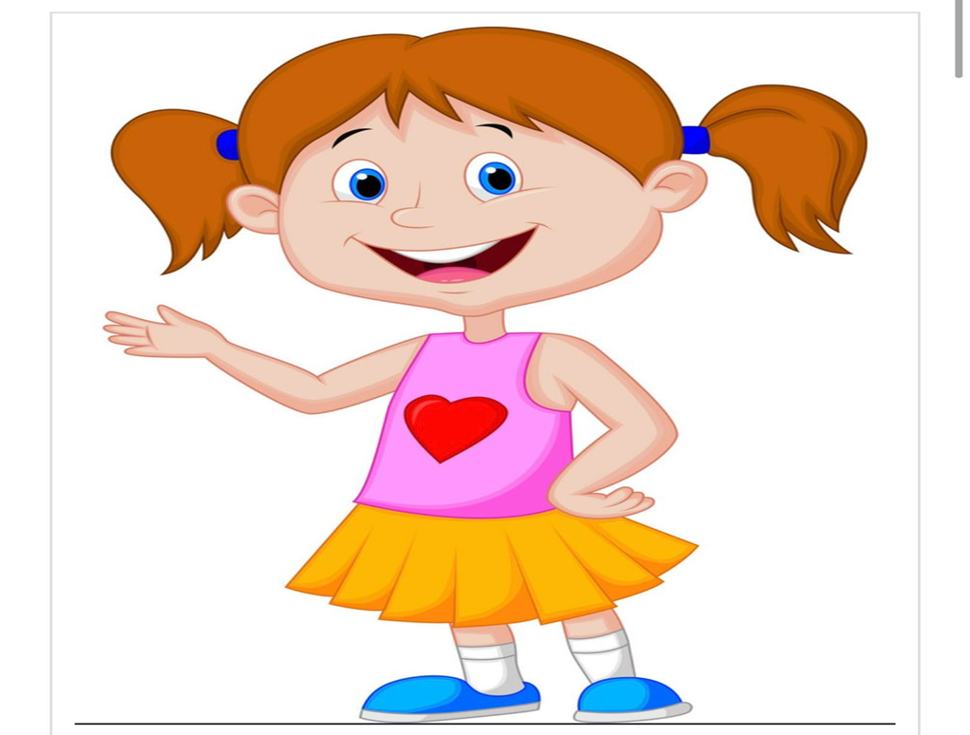
girl
I invite only the girls to my birthday party.

Slide 6
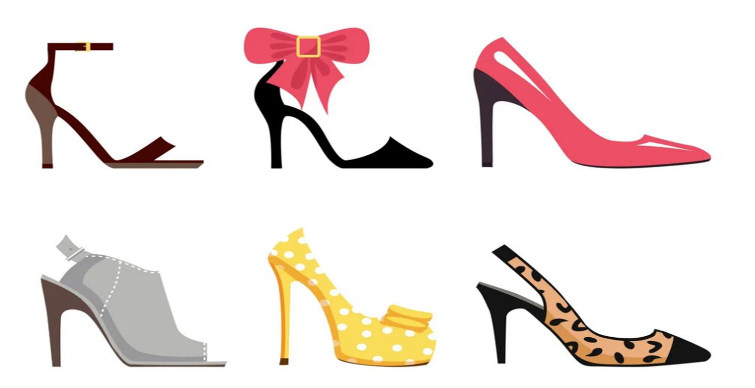
skirt
I want to wear a short skirt and high heels for the party.

Slide 7
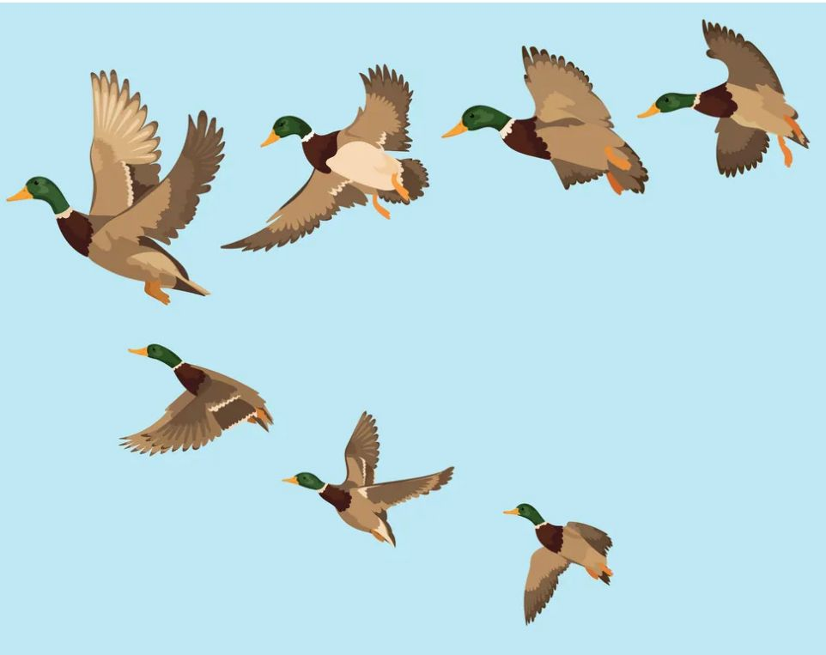
bird
A flock of birds fly up into the sky.

Slide 8
ur

Slide 9
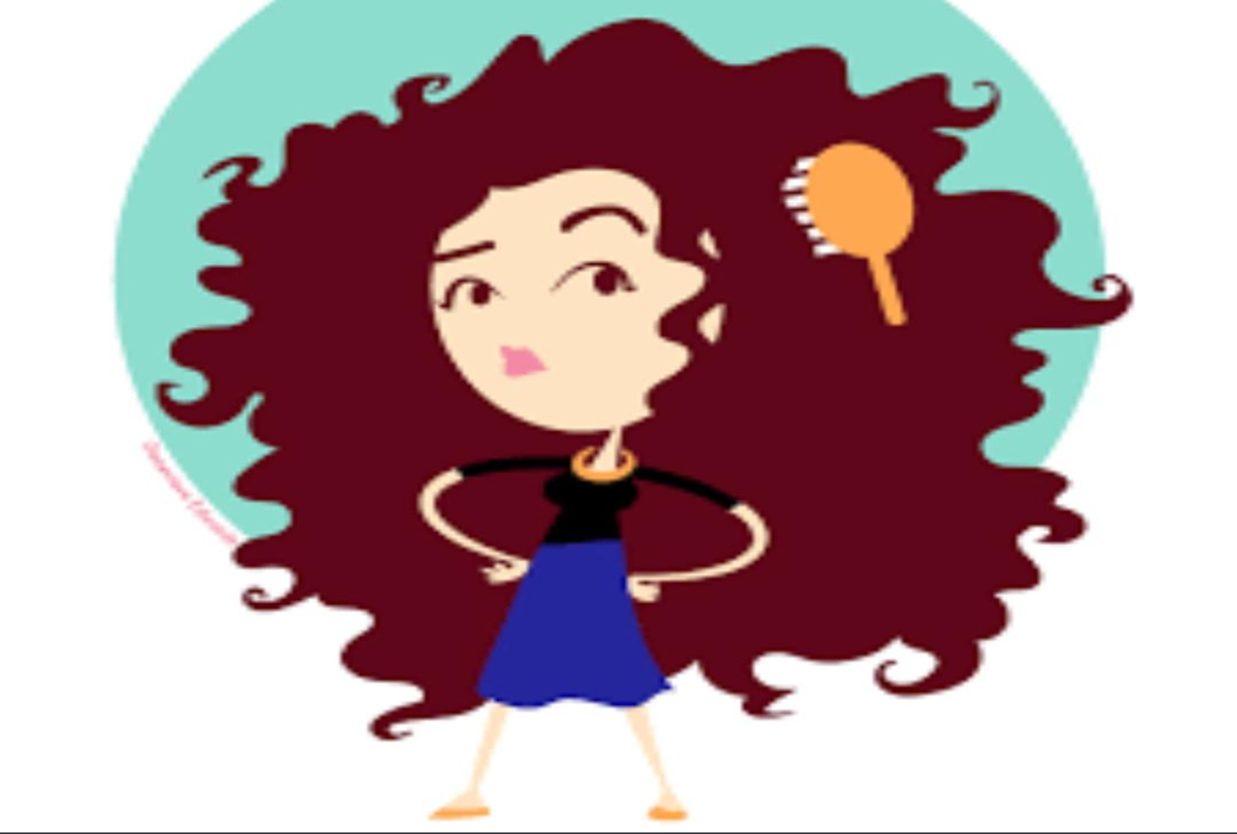
curly
It’s hard to brush curly hair.

Slide 10
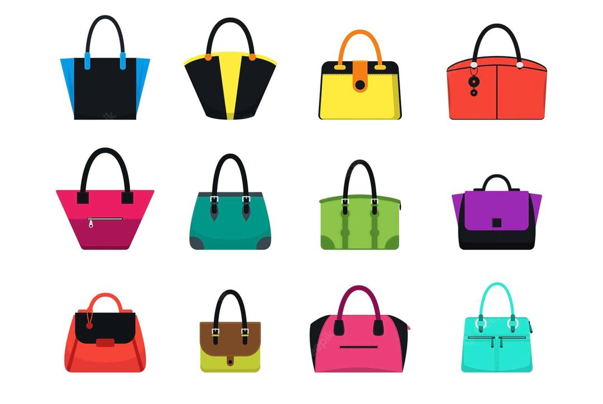
purse
I lock the door and drop the keys in my purse.

