Slide 1
ODI3P4, UNIT 8
MISS KIANA

Slide 2
Professor bloom and kids are checking the weather on earth. Because they want to come back soon.
Rose likes warm and sunny weather, she looks good with sunglasses.
She also likes wet weather so she’s happy on rainy days.
Harry hates humid weather, he thinks it’s sticky and hot.
Nobody likes stormy weather with a loud thunder and bright lightning.
They are so happy to go back to earth.

Slide 3
Unit 8/questions:
1.Where are they?
2.What are they doing?
3.Are they happy?
4.What are they talking about?
5.What is professor bloom doing?
6.How is the weather today?

Slide 4
Unit 8/personal questions:
1.Whats your favorite weather?
2.Why do you like sunny days?
3.Why don't you like windy weather?
4.What do you need in snowy weather?
5.What should we do in stormy weather?
6.What do you wear in sunny weather?

Slide 5
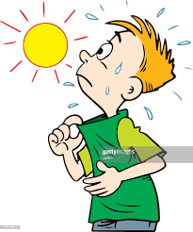
Warm= hot

Slide 6
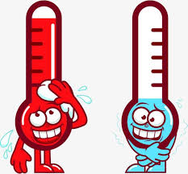
Temperature= Is how hot or cold something is.

Slide 7
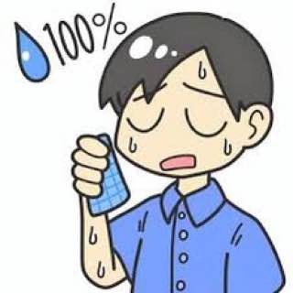
Humid= a high amount of water in the air but not liquid drops; in fog, rain or cloud.
Liquid drop
(water drop)
humid

Slide 8
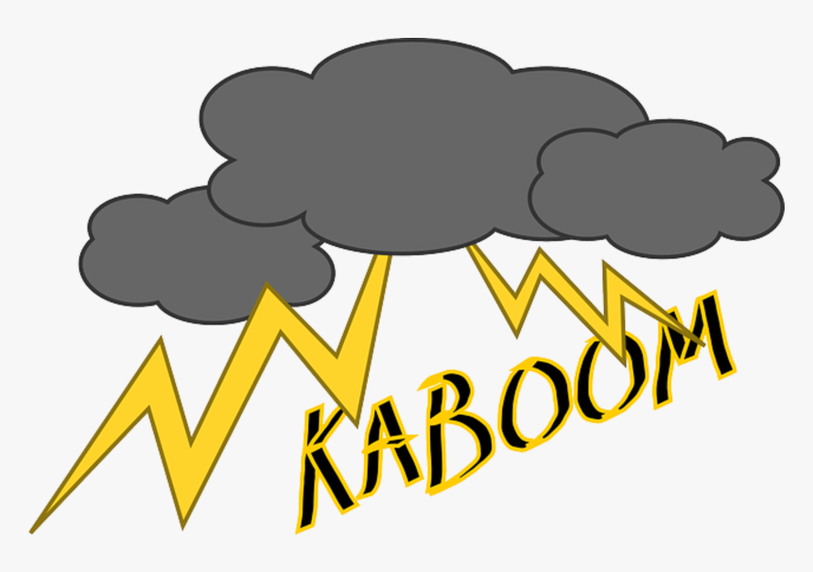
Thunder=loud sound of storm

Slide 9
Homework:
1.Memorise the meanings of new words.
2.Make sentence with new words.
3.Answer the questions of power point.
4.Do 2 pages of reading book of unit 8 and 1 page of activity book of unit 8.

Slide 10
Homework
do 2 pages of activity book and 1 page of reading book

