Slide 1
Odi starter2-session2
Teacher: miss saina

Slide 2
Parts of body:
head / tummy
neck / back
shoulders / legs
arms / toes
hand / feet
fingers

Slide 4
Pains and remedy:
1.Headache: When you have pain in your head
2.Earache: When you have pain in your ear.
3.Toothache: When you have pain in your tooth.
4.Sore throat: When you have pain in your throat.
5.Backache: When you have pain in your back.
6.Stomachache: When you have pain in your stomach/tummy.
7.Foot sore: When you have pain in your foot.

Slide 5
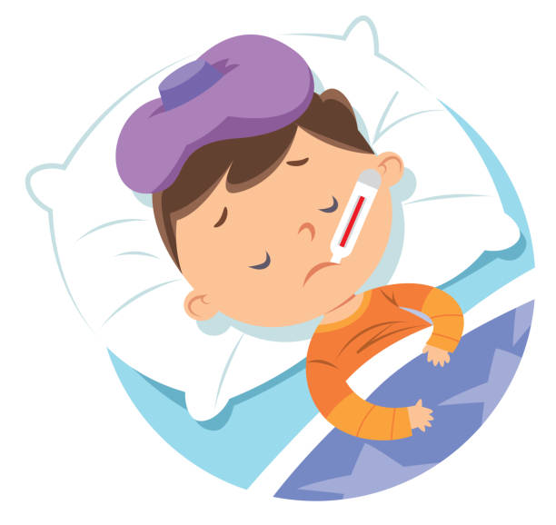
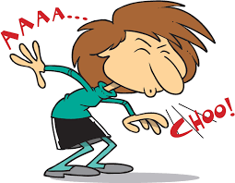
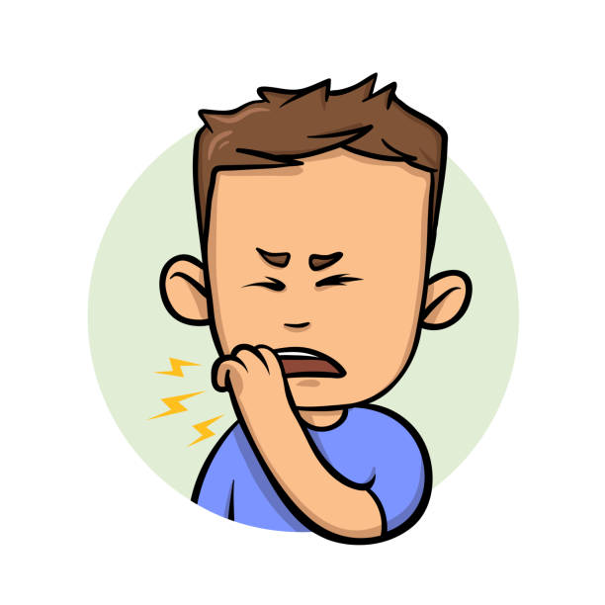
Pains and remedy:
Cough and sneeze: the air comes out from your lungs with a sharp sound.
Fever: your body gets hotter than usual.

Slide 6
I cut my finger.It’s bleeding. I need a plaster.

Slide 7
I burn my hand. It hurts. I need a bandage

Slide 8
I get sick. I feel pain. I need some pills.

Slide 9
I have cold, I have sore throat. I need syrup.

Slide 10
Personal questions:
1.Have you ever get sick?
2.How did you feel?
3.What was your problem?
4.Which medicines did you use?
5.What should we do when we get sick?
6.What should we do when our family member gets sick?

Slide 11
Homework
kianaabbasi13@gmail.com
DO 2 page of reading book and 1 page of activity book.

