Slide 1
Odi2p3- unit 6. birthday.

Slide 2
It’s Joe’s birthday!
He is celebrating with his family and Pippin.
They have lots of yummy foods for eating.
Joe likes toys so much. So everybody bought a nice toy for him.
He got a train set, board game, robot, kite and modeling clay for his birthday present.
Also, he got jigsaw puzzle, doll and coloring book from his school friends.
He is so glad and excited.

Slide 3
questions
When is your birthday
What do you do for your birthday?
Who do you celebrate with
What is your favorite birthday present?
Do you bake cake for your birthday or you buy cake for your birthday?

Slide 4
1 First 2 Second 3 Third 4 Fourth 5 Fifth 6 Sixth 7 Seventh 8 Eighth 9 Ninth 10 Tenth

Slide 5
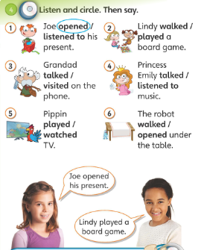
Verbs + ed
Talk = talked
Walk = walked
Play = played
Listen = listened
Watch = watched

Slide 6
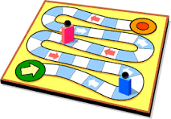
Board game

Slide 7
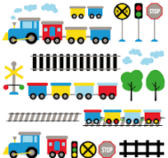
Train set

Slide 8
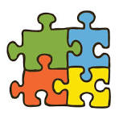
Jigsaw puzzle

Slide 9
Homework
do 2 pages of your activity book
and 1 page of your writing book

