Slide 1
ew

Slide 2
view
I open the window and look at the beautiful view.

Slide 3
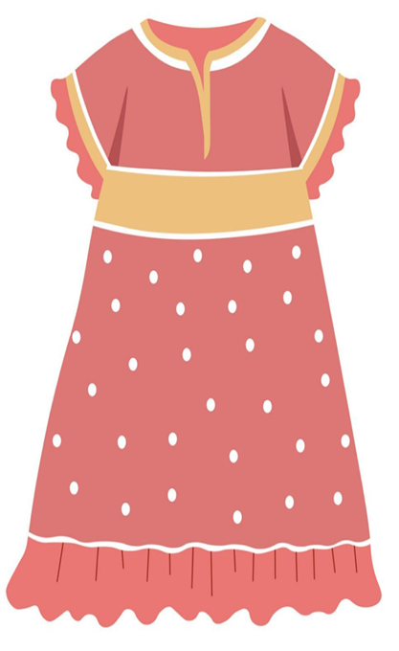
new
Do you like my new dress?

Slide 4
ue

Slide 5
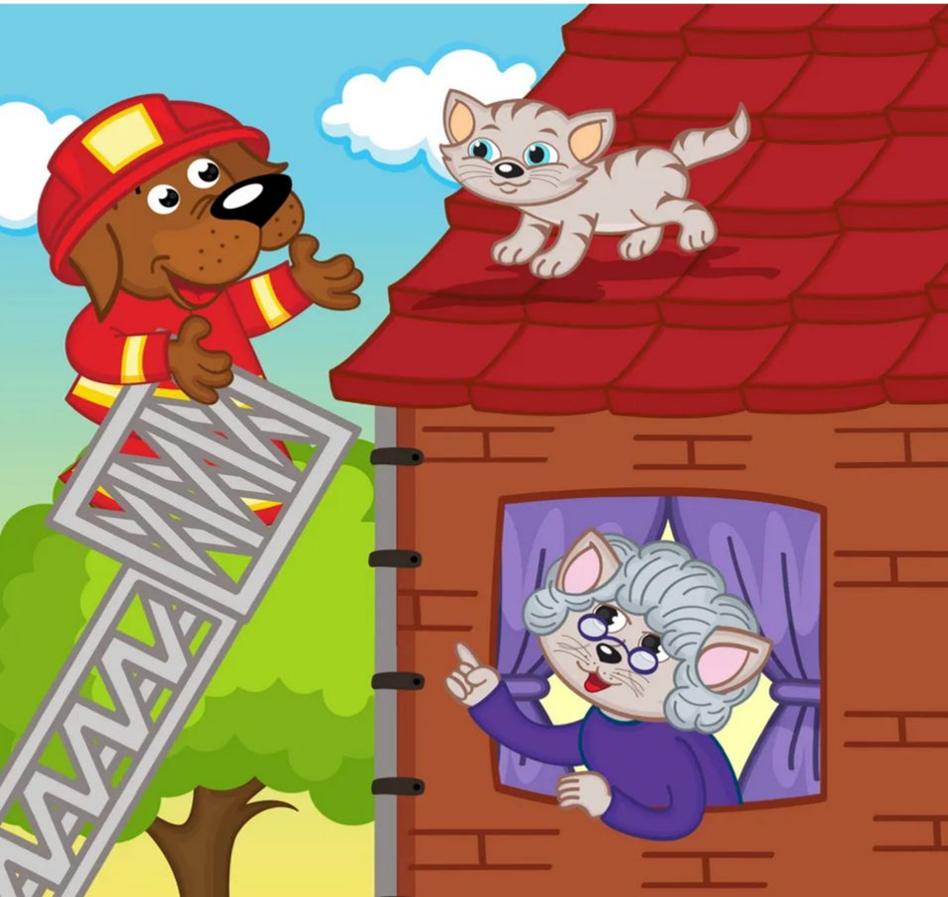
rescue
The fireman climbs the ladder and rescue the little cat.

Slide 6
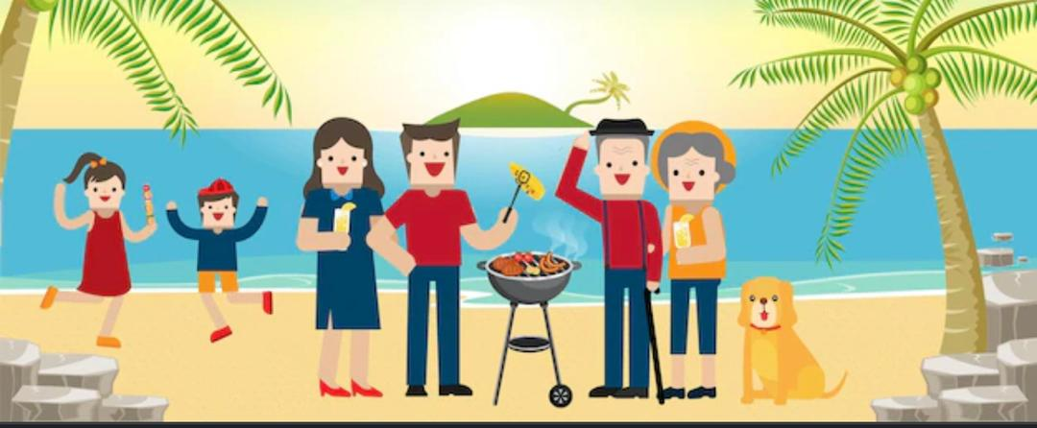
barbecue
We have a barbecue on the beach.

Slide 7
u-e

Slide 8
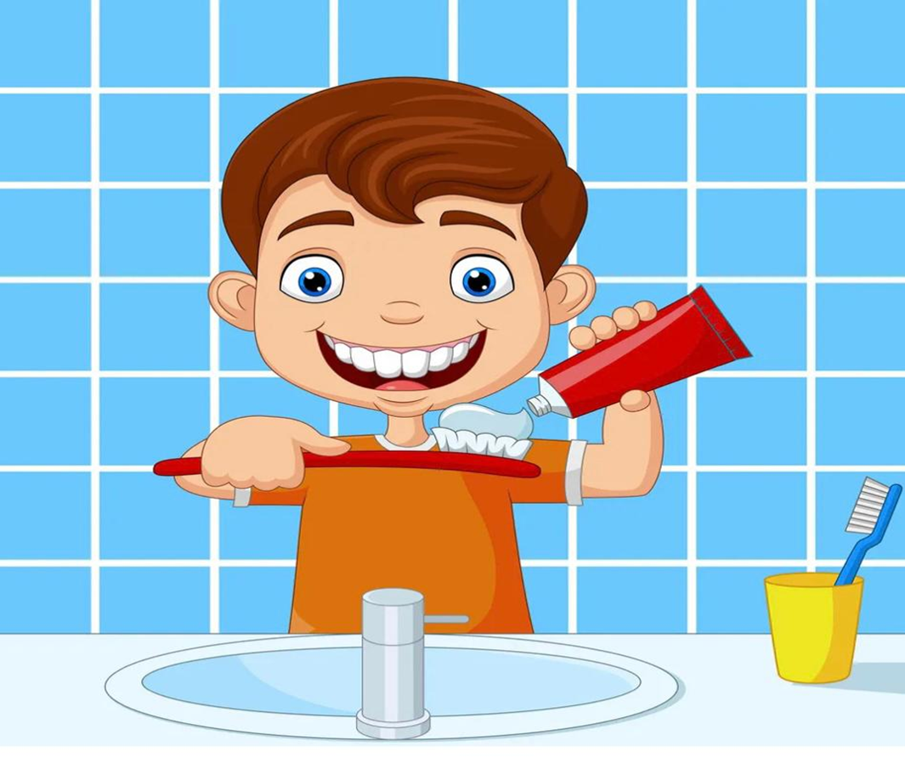
tube
I squeeze the toothpaste out of the tube.

Slide 9
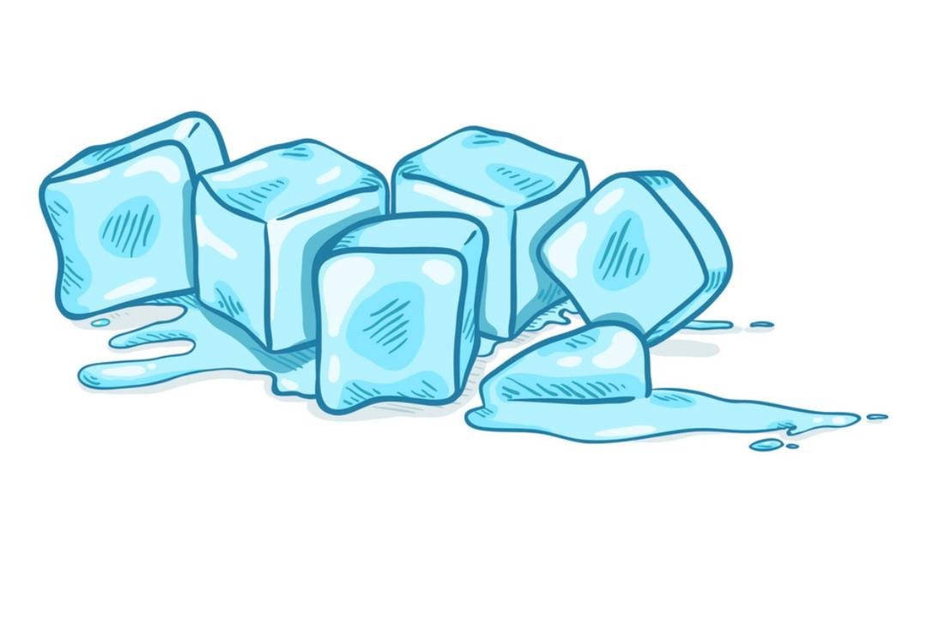
cube
please give me an ice cube out of the fridge.

Slide 10
