Slide 1
Unit 6 ODI starter

Slide 2
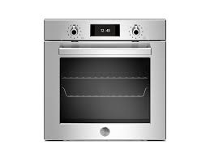
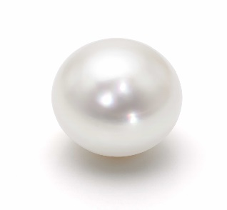
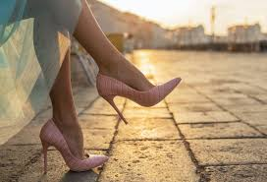
My home story:
Dad is taking a bath. He is in the bathtub. He is washing his body and singing a song. There are two towels in front of the window.
Rita is baking a cake on the oven in the kitchen. She is wearing apron.
Mom is in the living room .She is sitting on the sofa and reading a book. She is wearing pearl necklace and high heels .
Vava and Woldo are on the bed. Woldo is snoring and Vava can’t sleep .
Snoring: make a loud sound while sleeping.
Oven high heels pearl

Slide 3
Questions:
What is dad doing?
What is mom doing?
What is mom wearing?
Where is mom?
What is waldo doing?
What is Rita doing?
Have you ever baked the cake?

Slide 4
Answer the question:
How often do you take a shower? Twice a week/three times a week. Every day. every other day
Can you bake the cake? Yes, I can/No ,I can’t.
Do you help your mom ? Ye, I do. I set the table. I wash the dishes. I tidy my bedroom.
Do you snore ? No, I don’t.
Who snores in your family member?
What do you do in the kitchen?
What do you do n the living room?
What do you do in the bedroom?

Slide 5
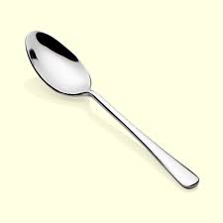
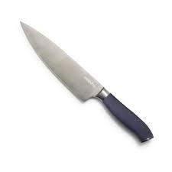
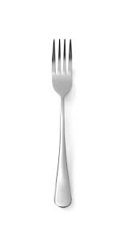
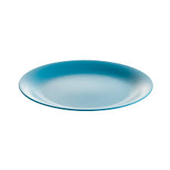
Kitchen:
spoon
What can you see in the kitchen?
Pan
Oven
Cooker
Sink
Fridge
Tap
Cupboards
Shelf
fork
knife
knife
plate
fork

Slide 6
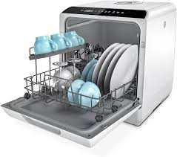
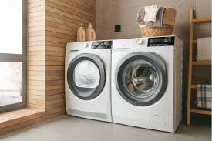
What do you do in the kitchen?
I wash the dishes.
I put the dishes in the dishwasher.
I put dirty clothes in the washing machine.
I bake the cake in the oven.
I cook food.
I eat meal.
Dish washer
Washing machine

Slide 7
Living room
What can you see in the living room?
There is a sofa.
There are cushions on the sofa.
There is a TV.
There is the table.
There is a carpet.
There is a curtain.
There are windows.
There are some arm chairs.

Slide 8
What do you do in the living room?
My dad reads newspaper.
My mom reads book.
We watch TV.
I sometimes do my homework.
I sometimes play with my toys.

Slide 9
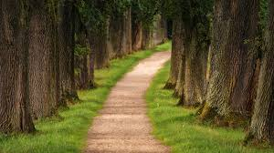
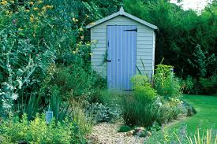
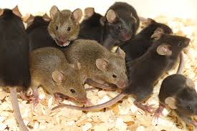
Read and write
path
This is the bathroom.
This is my living room.
There is a sink in the kitchen.
There are two windows in the BEDROOM.
Where is the sofa?
There are many mice.
The mouse is in the shed.
The mouse is on the path.
The mouse is in the bath tub.
shed
mice

Slide 10
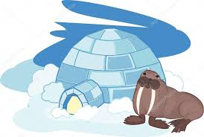
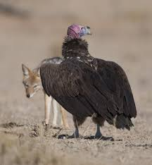
Look at these animals
walrus
vulture

Slide 11
Story page 48
Emily comes to Rita’s house to visit her best friend.
Rita’s dad is sitting on the sofa and he is greeting them.
They are passing the kitchen. Zak is baking the cake and he makes a mess. His mom is confused.
They go to Rita’s bed to play together.
Emily hears a voice .they decide to find that. they open the bathroom’s door and see Waldo is breathing fire and makes the bathtub hot.
Vava is excited.
Greeting means : a polite word of welcome and say hello.
Confused: you can’t think

Slide 12
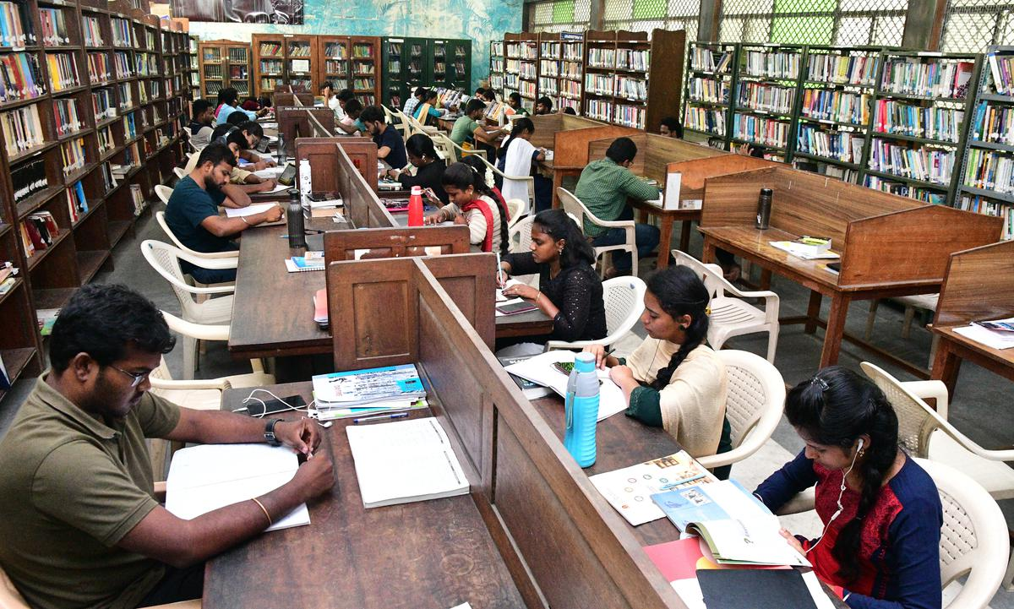
The buildings in the town:
Library:
It’s a place where many books are there.
You can study in the library
You can borrow the books.
Definitions:
Borrow: take something for a short time
you should give it back .opposite of lend

Slide 13
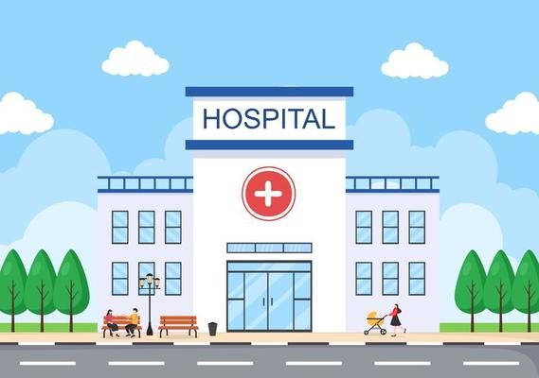
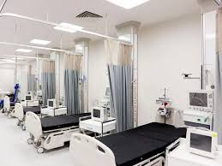
hospital
It’s a building where The patients go to get better.
Doctors and nurses work there.
Patient means ill person or sick person

Slide 14
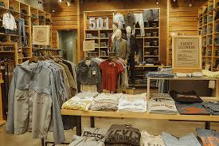
shop
You buy products .
Shop assistant sells you products.

Slide 15
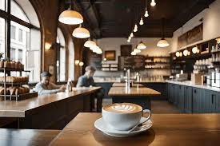
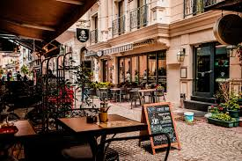
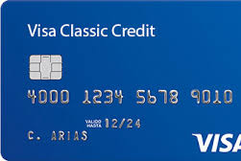
Café and restaurant
You order food or drink.
You pay money by cash , credit card OR debit card

Slide 16
Park what can you do?

