Slide 1
Hello everyone
Sep
Oct
Nov
Dec
Jan
Feb
Mar
Apr
May
Jun
Jul
Aug
A
B
C
D
Unit 7
E
F

Slide 2
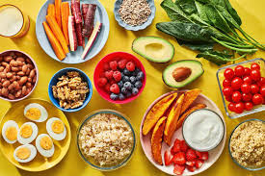
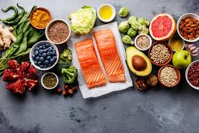
Healthy food
Helps you grow.
Helps you stay fit.
Helps you be strong.

Slide 3
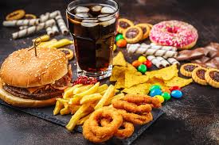
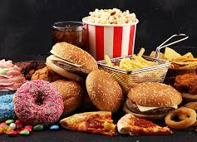
Unhealthy food
Makes you ill.
Makes you fat.
Makes you weak.

Slide 4
Look at page 52-53
What has Rita got?
She has got bread and cheese.
What has mom got?
What has dad got
Where are they?
What has Waldo got?
He has got a pacifier.
What is behind the car?
Do you like fried chicken for lunch?
Does Zak like fruit?
Does Rita eat meat?

Slide 5
do/does
I like honey .
I don’t like bread.
The bear likes honey .
The bear doesn’t like jelly.
Does it like a banana?
Yes, it does./No , it doesn’t.
Do you like a banana?
Yes, I do./ No, I don’t.

Slide 6
Dictation:
Honey
Does Banana
Cheese Bread
Jelly Fruit
What Yoghurt
Juice Meat
Milk Jelly fish
Yak Small
Food animal

Slide 7
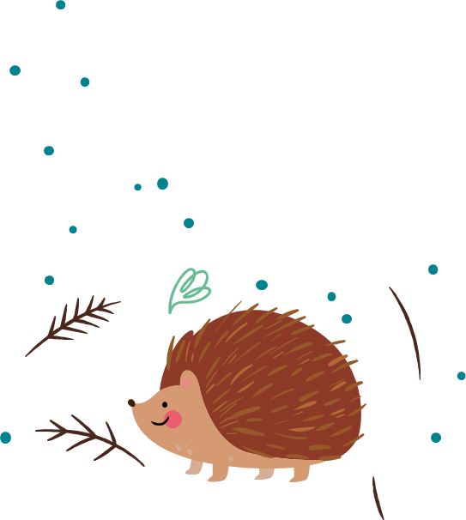
HOMEWORK:
PRACTICE DICTATION !
Make 5 questions about the bear page 60 and answer them.

