Slide 1
Hello everyone
Sep
Oct
Nov
Dec
Jan
Feb
Mar
Apr
May
Jun
Jul
Aug
A
B
C
D
Unit 7
E
F

Slide 2
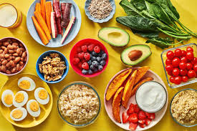
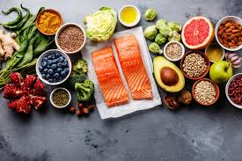
Healthy food
Helps you grow.
Helps you stay fit.
Helps you be strong.

Slide 3
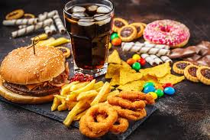
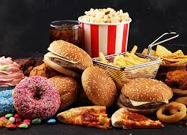
Unhealthy food
Makes you ill.
Makes you fat.
Makes you weak.

Slide 4
Look at page 52-53
What has Rita got?
She has got bread and cheese.
What has mom got?
What has dad got
Where are they?
What has Waldo got?
He has got a pacifier.
What is behind the car?
Do you like fried chicken for lunch?
Does Zak like fruit?
Does Rita eat meat?

Slide 5
do/does
I like honey .
I don’t like bread.
The bear likes honey .
The bear doesn’t like jelly.
Does it like a banana?
Yes, it does./No , it doesn’t.
Do you like a banana?
Yes, I do./ No, I don’t.

Slide 6
Dictation:
Honey
Does Banana
Cheese Bread
Jelly Fruit
What Yoghurt
Juice Meat
Milk Jelly fish
Yak Small
Food animal
Bedroom-bathroom-door-kitchen-living room-path-shed-garden-

Slide 7
Story page 56
They are coming back home and Woldo decides to fly .
In the car kids fasten their seatbelts.
They are talking about their favorite food ,they feel so hungry. Rita is asking Vava ,what he likes.
Vava is thinking about that , he doesn’t like fish but he prefers ice-cream ,pacifier and cupcake.
They reach home and each of them wants to eat something.
They find Waldo, he has already eaten all the food
And now he has got stomachache.

Slide 8
Homework:
Write once from the story
You have mid tern practice unit 6 and 7
Study my power points
Study dictation from this
power point

Slide 9
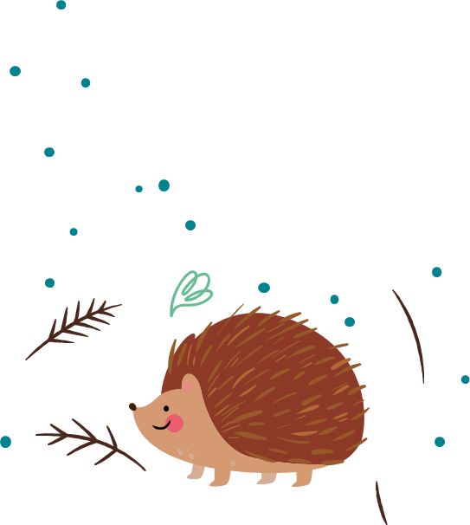
Thanks!

