Slide 1
Hello everyone
Sep
Oct
Nov
Dec
Jan
Feb
Mar
Apr
May
Jun
Jul
Aug
A
B
C
D
Unit 8
E
F

Slide 2
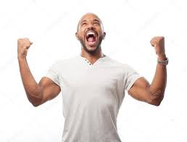
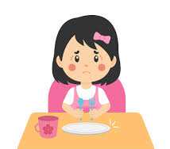
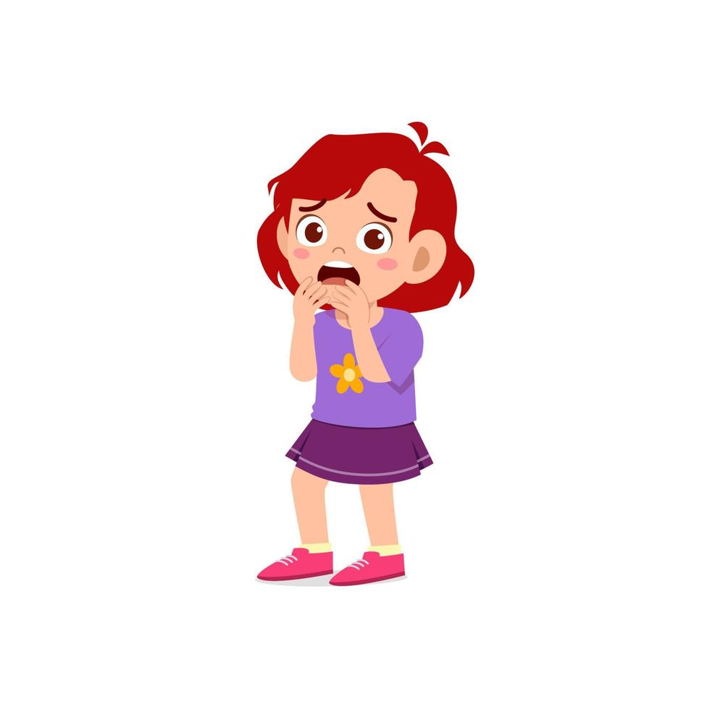
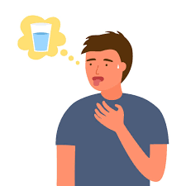
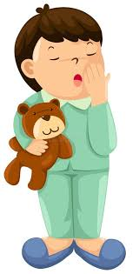
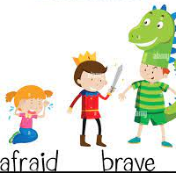
emotions:
excited
hungry
afraid
Tired-sleepy
thirsty

Slide 3
How does he feel?
He is tired.
She is sleepy.
He is excited.

Slide 4
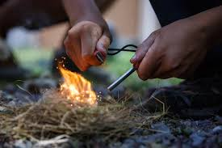
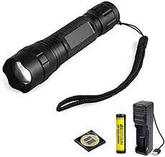
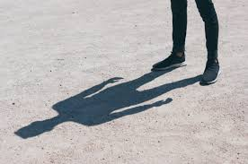
hammock
Make fire
torch
shadow
logs

Slide 5
Ask and answer
Is he tired? Yes, he is.
Is she sleepy ? No, she isn’t.
Are you excited? Yes, I am.

Slide 6
Dictation:
Thirsty-angry-happy-sad-excited-tired-sleepy-emotions-hungry

Slide 7
Thanks!

Slide 8
Homework:
Study power point
Make sentences with:hungry-thirsty-sleepy-excited
Practice dictation

