Slide 1
Hello everyone
Sep
Oct
Nov
Dec
Jan
Feb
Mar
Apr
May
Jun
Jul
Aug
A
B
C
D
Unit 8
E
F

Slide 2
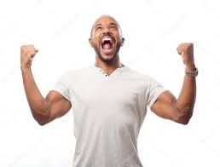
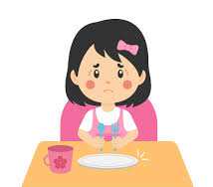
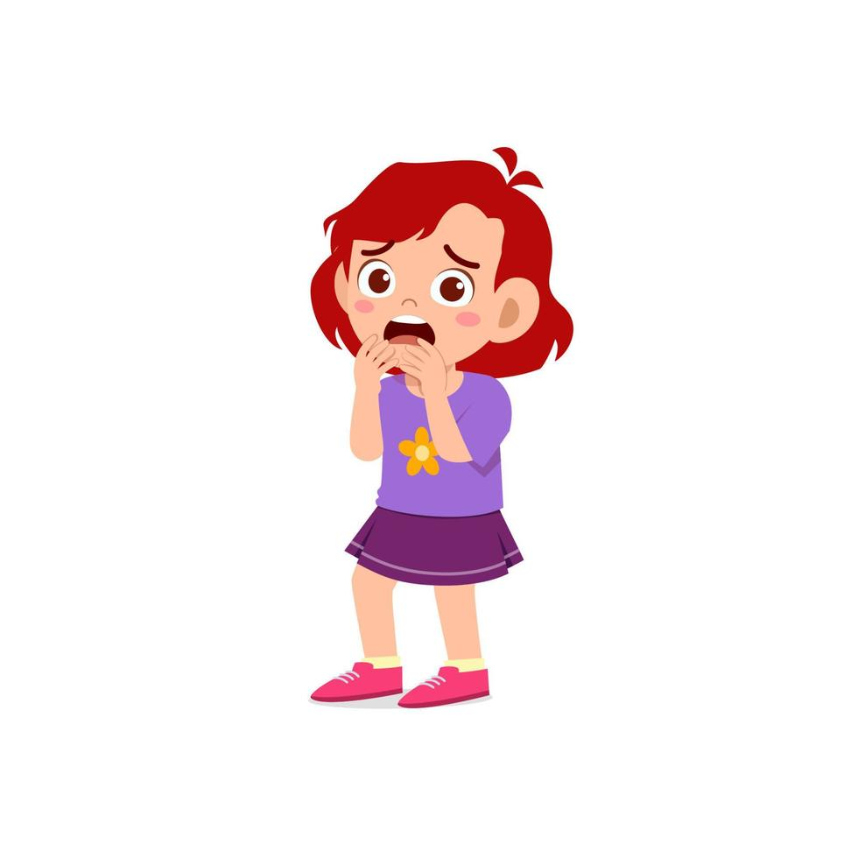
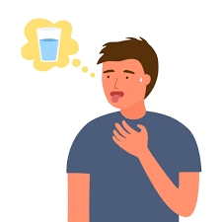
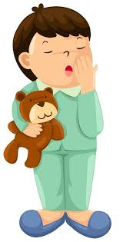
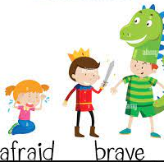
emotions:
excited
hungry
afraid
Tired-sleepy
thirsty

Slide 3
How does he feel?
He is tired.
She is sleepy.
He is excited.

Slide 4
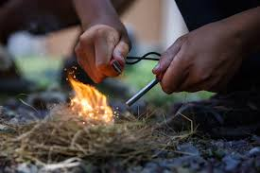
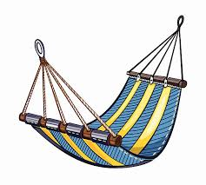
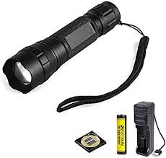
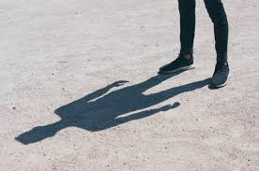
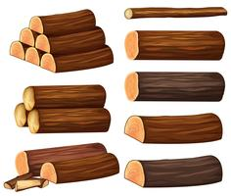
hammock
Make fire
torch
shadow
logs

Slide 5
Ask and answer
Is he tired? Yes, he is.
Is she sleepy ? No, she isn’t.
Are you excited? Yes, I am.

Slide 6
page 61-62
Where are they?
How does Rita feel?
How does Oscar feel?
Where is Oscar? what is he doing?
How does Wolda feel?
Why is woldo excited?
What can you see?

Slide 7
Dictation:
Thirsty-angry-happy-sad-excited-tired-sleepy-emotions-hungry

Slide 8
Story page 56
They go camping in the jungle.
It is night out there and Emily is scared from something in the tree.
Rita is out of water , she is thirsty.
Oscar is on the hammock and he is sleepy. Waldo is looking at the shadow with the torch that looks like her mom .he is very excited.

Slide 9

Thanks!

Slide 10
Homework:
Write once from the story page 56
Study the power point
Study dictation from this
power point

