Slide 1
Musical instruments
How many musical instruments do we have ? We have 3 kinds
Of musical instruments
a. Wind instruments : flute , saxophone , trumpet
b. Percussion instruments : drum , cymbals , triangle
c. Stringed instruments : violin , piano , harp , guitar

Slide 2
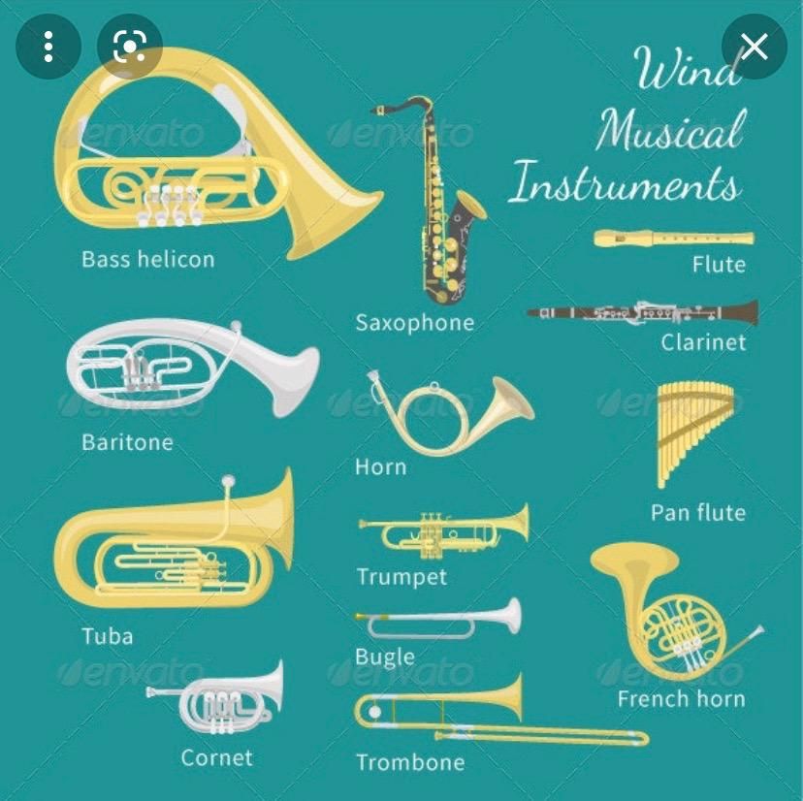
Wind instruments

Slide 3
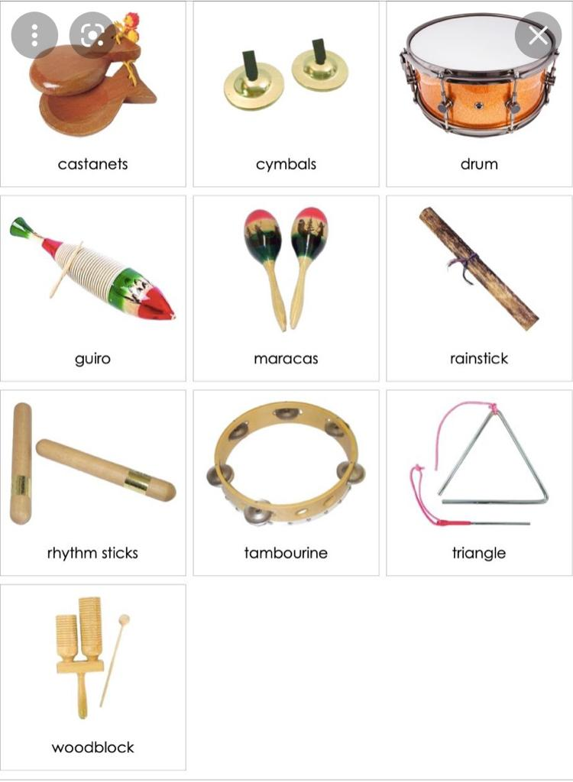
Percussion instruments

Slide 4
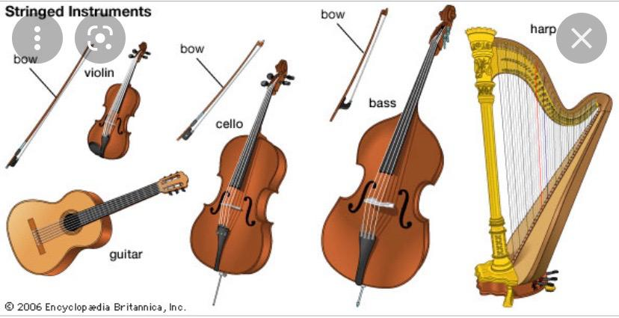
Stringed instruments

