Slide 1
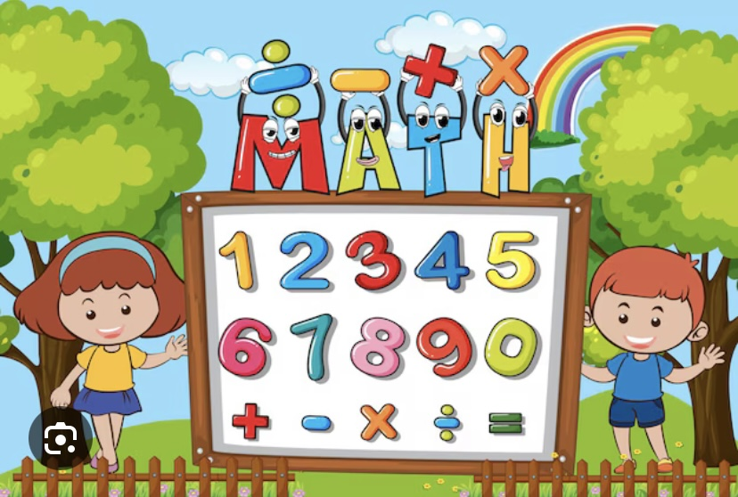
lessons
math
PE

Slide 2
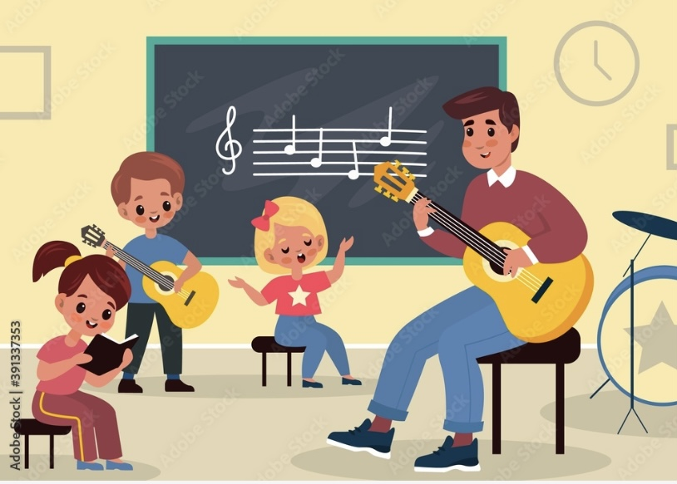
MUSIC
Geography

Slide 3
science
literature

Slide 4
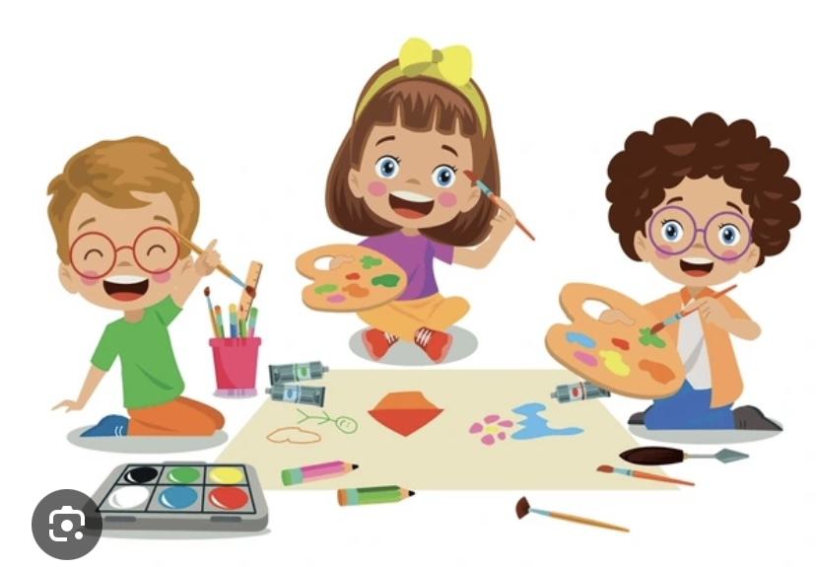
Art

